Slide 1
BRIEFING

Slide 2
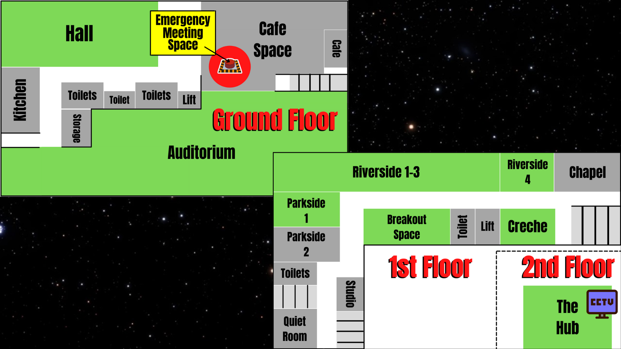

Slide 3
How to play
You will either be an IMPOSTOR or CREWMATE – KEEP THIS SECRET!!!
CREWMATES – Complete each task & collect a stamp for each one on your hand
(if 3 Crewmates get all marks on their hand & show leader in the Emergency Meeting space, the Crewmates WIN!)
IMPOSTORS – Kill the crewmates (tap them and show your Impostor card) – you can fake doing the tasks
When you’re killed, lie on the floor until you are found and reported – then go to the Emergency Meeting Space (Café)
To report a body, blow loudly on your whistle and everybody to go the EMERGENCY MEETING SPACE to vote (Café)
– max. 1 min to discuss and vote!
If you are voted off, go to the Emergency Meeting Space (Café)

Slide 4
RULES
No Emergency Meetings – only report bodies
Impostor must count 15 Mississippi’s between each kill (be honest!)
No running (do a funny walk like they do in the game)
Only enter areas marked in green on the map
If killed/voted off, stay in the Emergency Meeting Space (Café) until the end of the game
Don’t travel in groups (too obvious!)
No hiding in toilets, cupboards or outside
Don’t move or sabotage any tasks or cameras

Slide 5
READY?!

