Slide 1
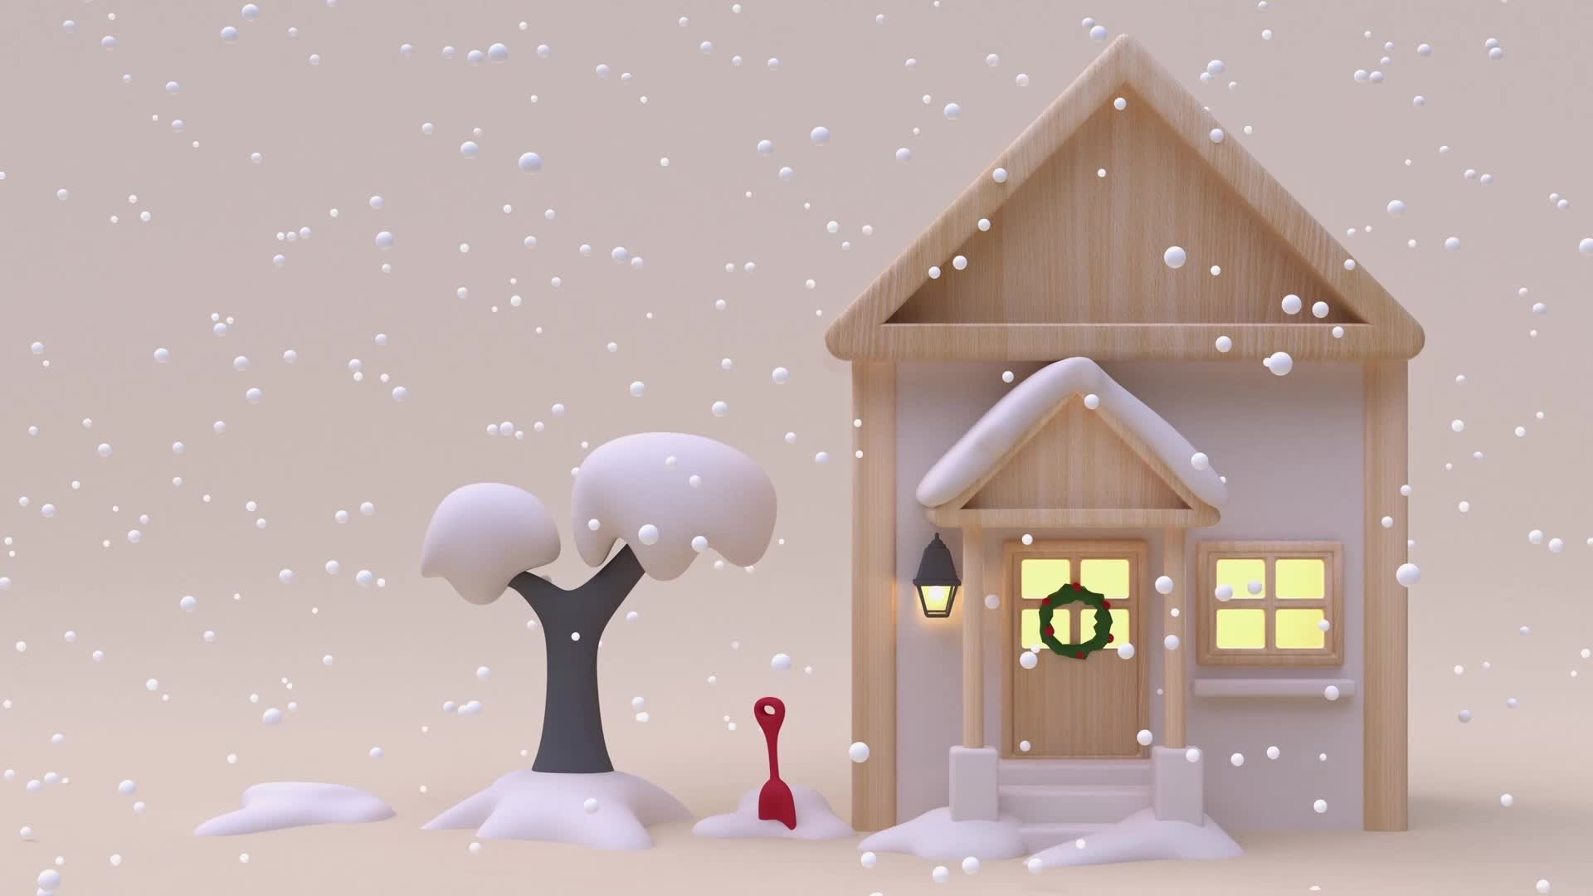
EMOJI CHRISTMAS SONGS
Find more Christmas games at www.churchyouthministry.com

Slide 2
Work out the famous Christmas songs or carols from the emoji clues
Here’s an example:
🎸
🎄
Rockin’ around the Christmas tree

Slide 3
1.
🔔
🔔

Slide 4
2.
🌃
😮
🧀

Slide 5
3.
🗽
🧚
📕

Slide 6
4.
👂🏽
👼🏻
📣
👼🏻
🎶
🎶

Slide 7
5.
🥶
❄️
👴🏾

Slide 8
6.
🇱
🥇
🙅🏻

Slide 9
7.
👶🏽
😇
🎅🏻

Slide 10

8.
🎄
🎁

Slide 11
9.
🥳
🌍

Slide 12
10.
🏃🏽‍♀️
🦌
🏃🏿‍♂️

Slide 13
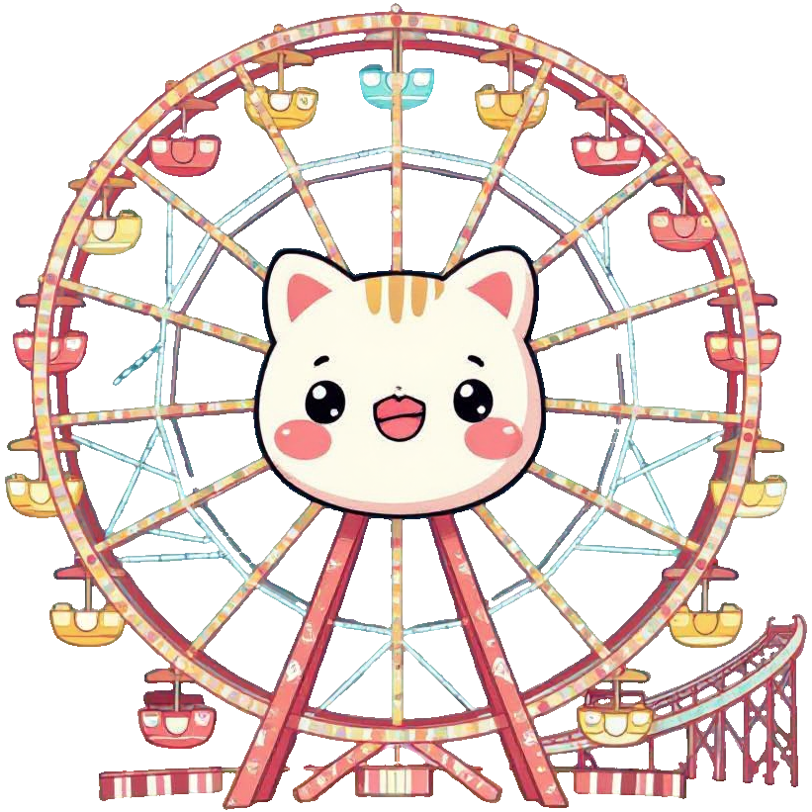

11.

Slide 14
12.
?
👂🏽
🙋🏾
👂🏽
👁️

Slide 15
13.
🏢
🎅🏻
🏠
🏠
🏠

Slide 16

14.
2025
December
Notes:
Note: You may need to change the year to be last year.

Slide 17

15.

Slide 18
16.
⚔️
☺️
December

Slide 19
17.
🎅🏻
👀
👩🏻‍👦🏻
💋

Slide 20
18.
❄️
❄️
❄️
❄️
❄️
❄️
❄️

Slide 21
19.
🎅🏻

Slide 22
20.
🧍🏻‍♂️
👶🏽
🥁

Slide 23
Ready for the answers?
🎸
🎄

Slide 24
1.
Jingle bells
🔔
🔔

Slide 25
2.
O holy night
🌃
😮
🧀

Slide 26
3.
Fairytale of New York
🗽
🧚
📕

Slide 27
4.
Hark the herald angels sing
👂🏽
👼🏻
📣
👼🏻
🎶
🎶

Slide 28
5.
Frosty the Snowman
🥶
❄️
👴🏾

Slide 29
6.
The first Noel
🇱
🥇
🙅🏻

Slide 30
7.
Little Saint Nick
👶🏽
😇
🎅🏻

Slide 31
8.
Underneath the Tree
🎄
🎁

Slide 32
9.
Joy to the world
🥳
🌍

Slide 33
10.
Run Rudolph run
🏃🏽‍♀️
🦌
🏃🏿‍♂️

Slide 34
11.
Winter Wonderland

Slide 35
12.
Do you hear what I hear?
?
👂🏽
👂🏽
🙋🏾
👁️

Slide 36
13.
Santa Claus is coming to town
🏢
🎅🏻
🏠
🏠
🏠

Slide 37
14.
Last Christmas
2025
December
Notes:
Note: You may need to change the year to be last year.

Slide 38
15.
Santa Baby
Notes:
Note: You may need to change the year to be last year.

Slide 39
16.
Happy Christmas (War is over)
⚔️
☺️
December
Notes:
Note: You may need to change the year to be last year.

Slide 40
17.
I saw mummy kissing Santa Claus
🎅🏻
👀
👩🏻‍👦🏻
💋

Slide 41
18.
Let it snow
❄️
❄️
❄️
❄️
❄️
❄️
❄️

Slide 42
19.
🎅🏻
Here comes Santa Claus

Slide 43
20.
Little drummer boy
🧍🏻‍♂️
👶🏽
🥁

Slide 44
EMOJI CHRISTMAS SONGS
Find more Christmas games at www.churchyouthministry.com

