Slide 1

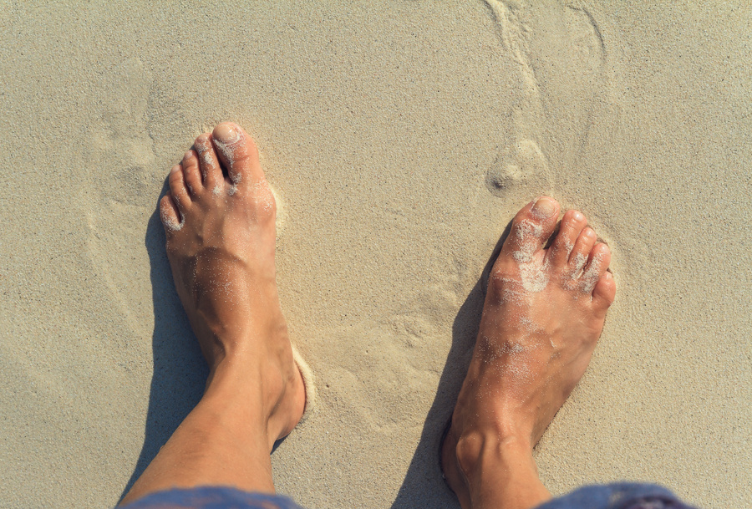
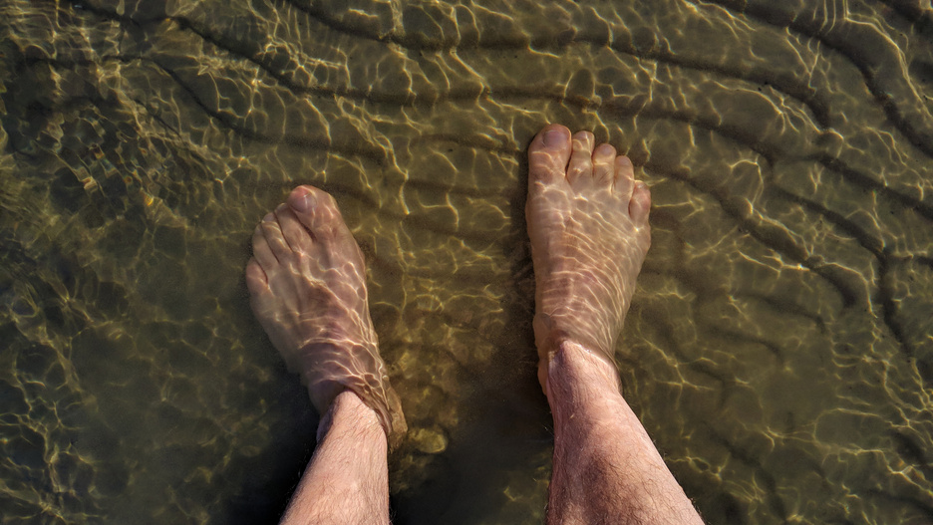

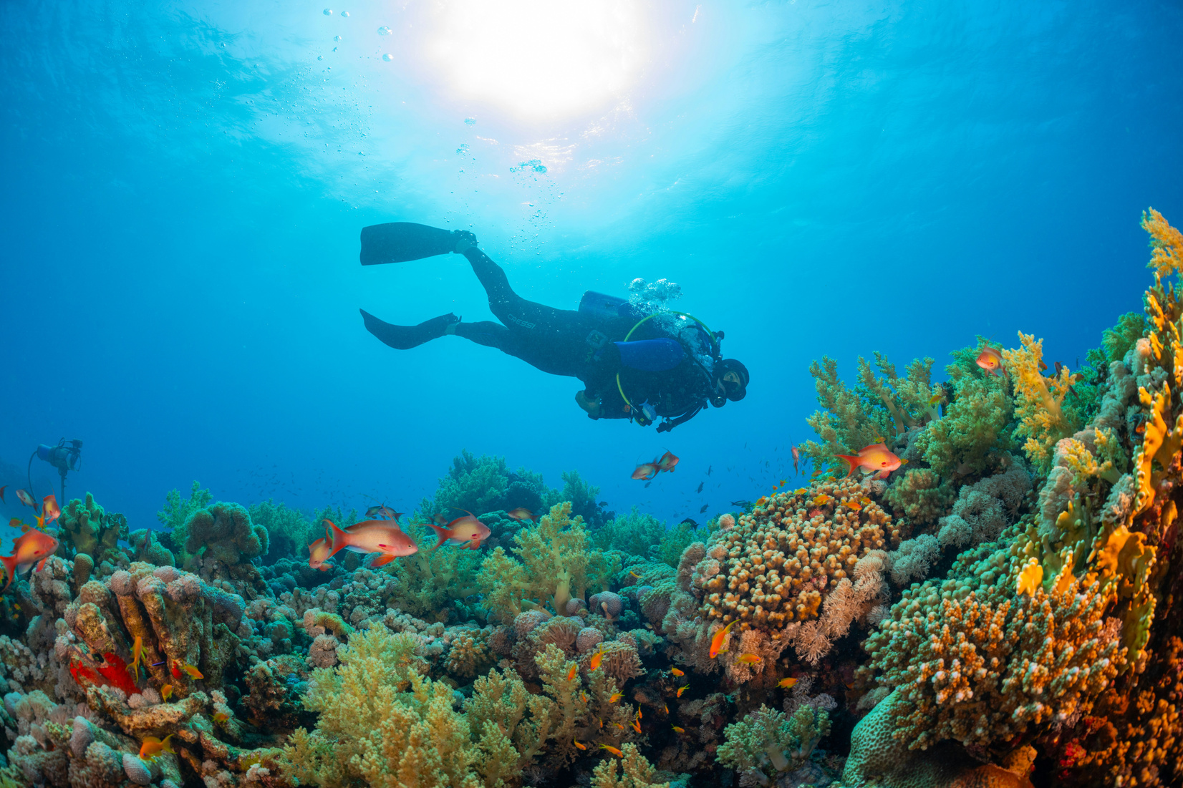
ON THE
BEACH
SCUBA
DIVING
PADDLING
SNORKELLING
Looking at the view
Staying in the shallows
Getting your hair wet
Going really deep

Slide 2
ON THE
BEACH
Looking at the view
  You wouldn’t call yourself a Christian.
  You’re on the edge and looking on.

Slide 3
PADDLING
Staying in the shallows
  You’d call yourself a Christian, but you’re still quite new to it and want to stay in the shallows.
  You’ve got loads of questions.

Slide 4
SNORKELLING
Geting your hair wet
  You’d call yourself a Christian,
  but you want to go a bit deeper, get a bit closer to God and work out how to live out your faith in practice.
  You’ve still got questions...

Slide 5
SCUBA
DIVING
Going really deep
  You’ve been a Christian a while and you’re all in.
  You want to get into the Bible more and maybe grow into leading other people towards faith...
  ...and you’ve still got questions.

Slide 6
ON THE
BEACH
SCUBA
DIVING
PADDLING
SNORKELLING
Looking at the view
Staying in the shallows
Getting your hair wet
Going really deep

