Slide 1

Designs by Jonah Ling Created by Louise Grainger, Michael Weatherall, Dave Thornton, Eleanor Bristowe and Hannah Elphick

Slide 2
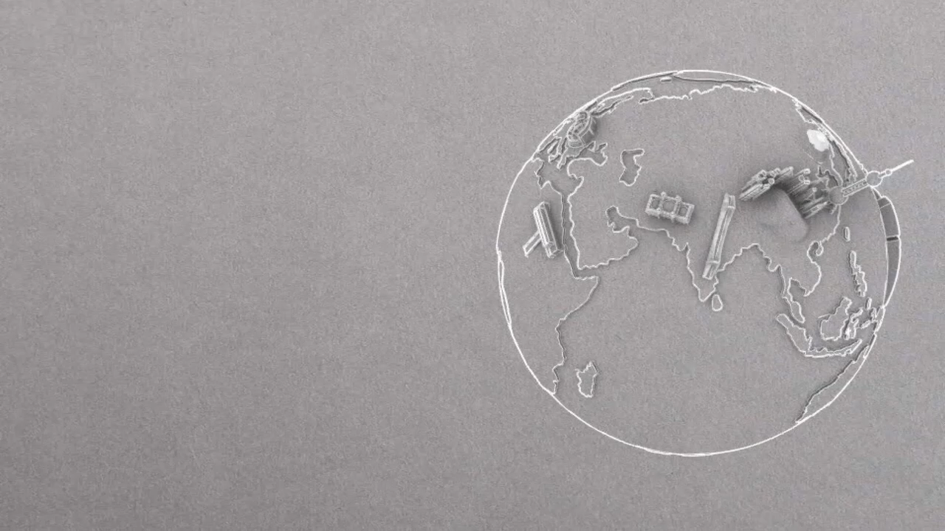
Can you get
round the world?

Slide 3
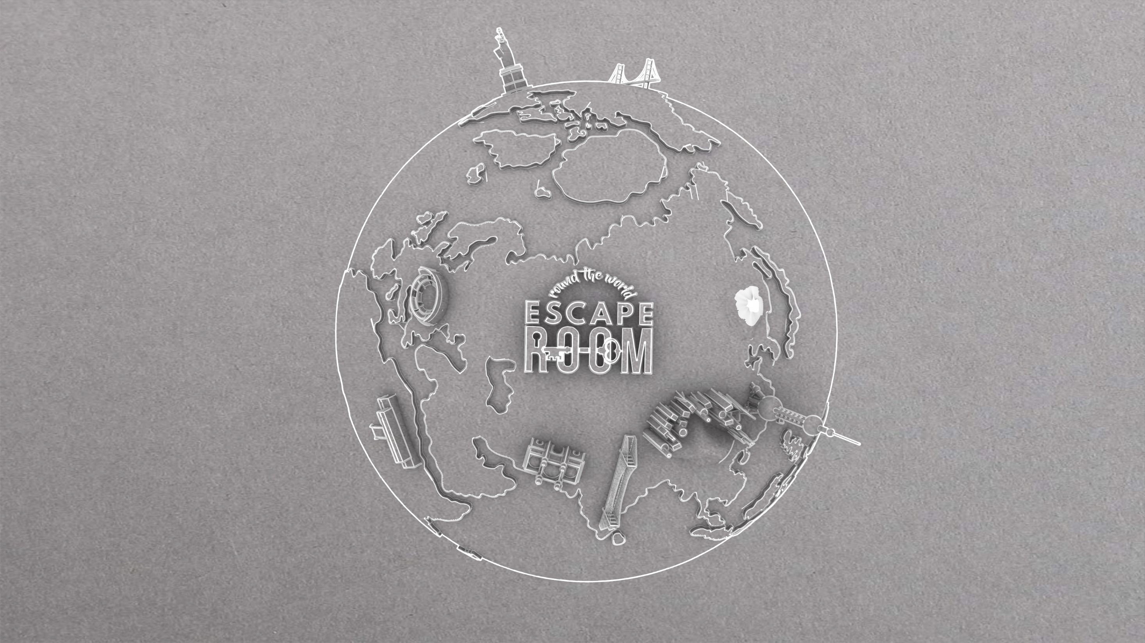
Start the stopwatch!
Designs by Jonah Ling Created by Louise Grainger, Michael Weatherall, Dave Thornton, Eleanor Bristowe and Hannah Elphick

Slide 4


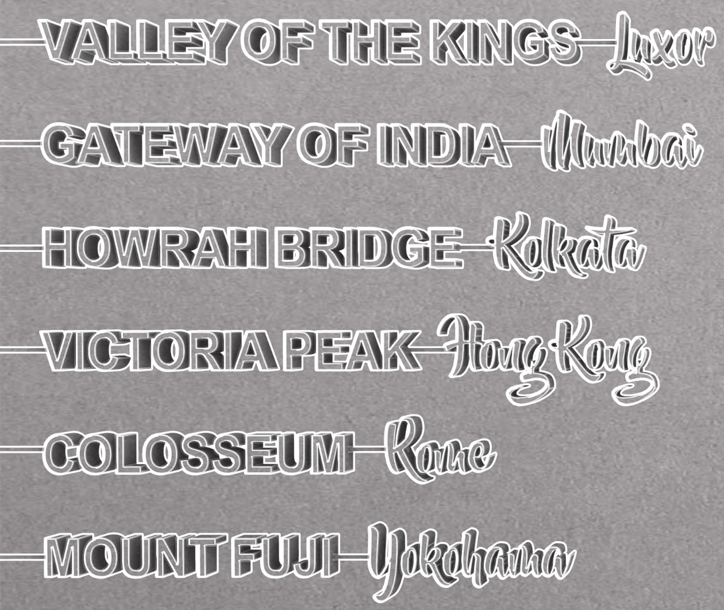


CLICK ON A LOCATION TO TRAVEL THERE

Slide 5



Slide 6

Build a Tower
You need to each build a tower of 6 items. Each item needs to be smaller than the item below it…

Slide 7

Congratulations!
CLICK ON THE GLOBE ICON TO CONTINUE

Slide 8


Slide 9
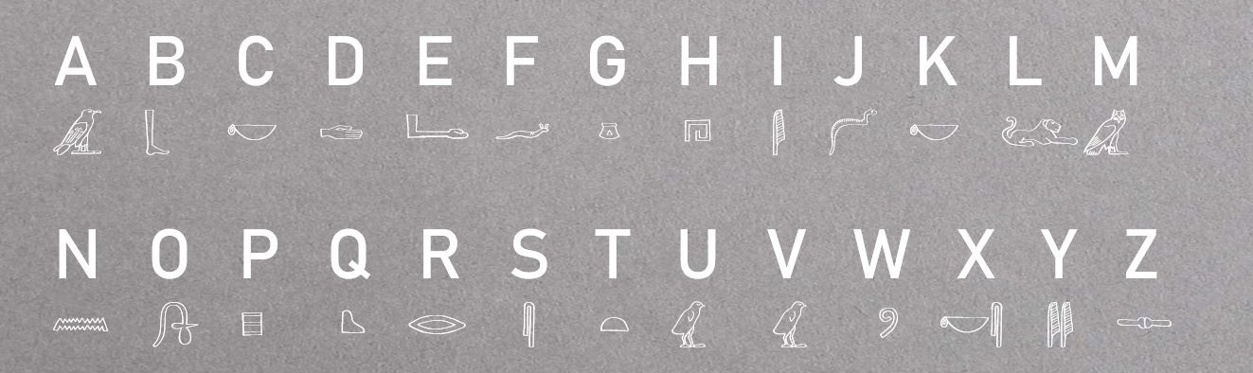
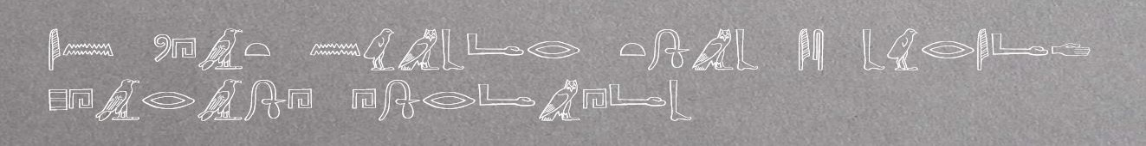
Crack The Hieroglyphics
TRANSLATE THIS SENTENCE AND ANSWER THE QUESTION:

Slide 10
Congratulations!
CLICK ON THE GLOBE ICON TO CONTINUE

Slide 11
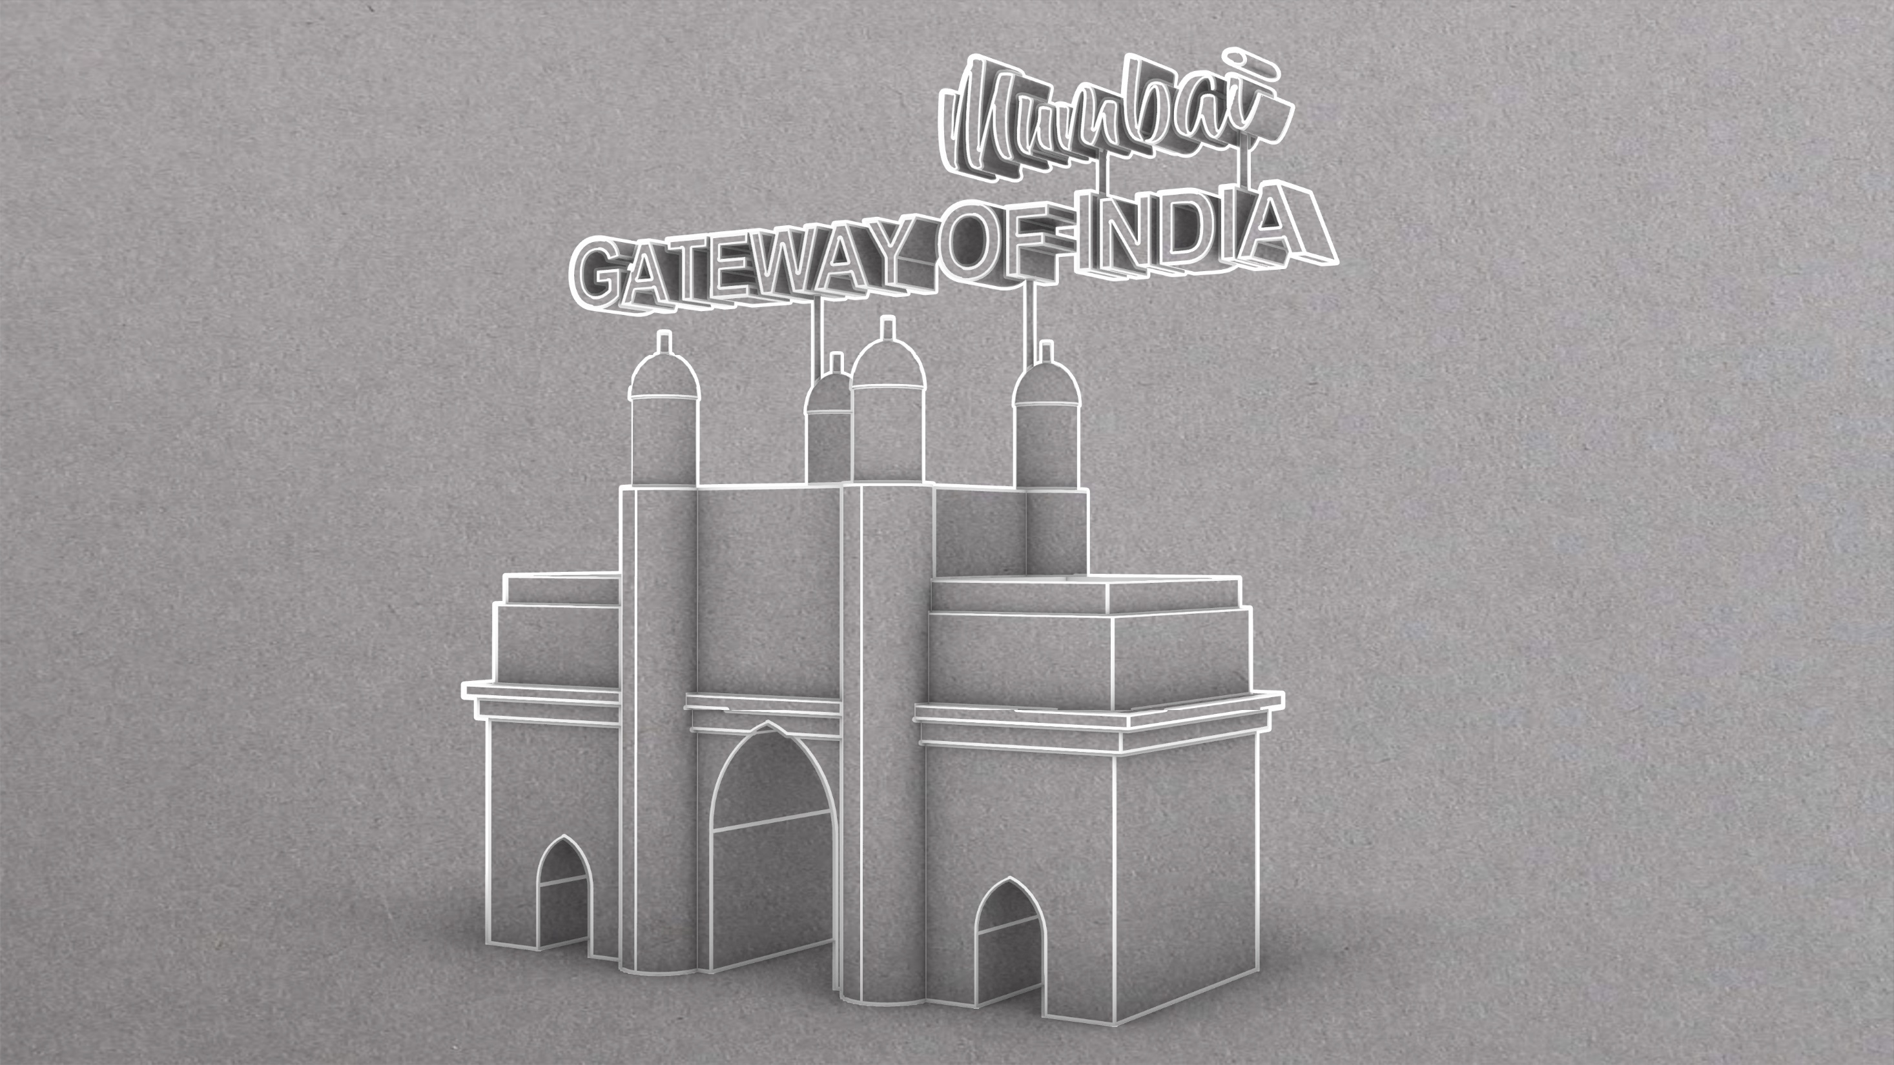

Slide 12
Get To Mumbai
Head to Qatar Airways’ website
Which flight do you want to catch for the shorter possible journey time to Mumbai (BOM) on 13th December 2026?
Leaving London Heathrow (LHR) at 05:55
OR
Leaving London Heathrow (LHR) at 08:35

Slide 13
Congratulations!
CLICK ON THE GLOBE ICON TO CONTINUE

Slide 14
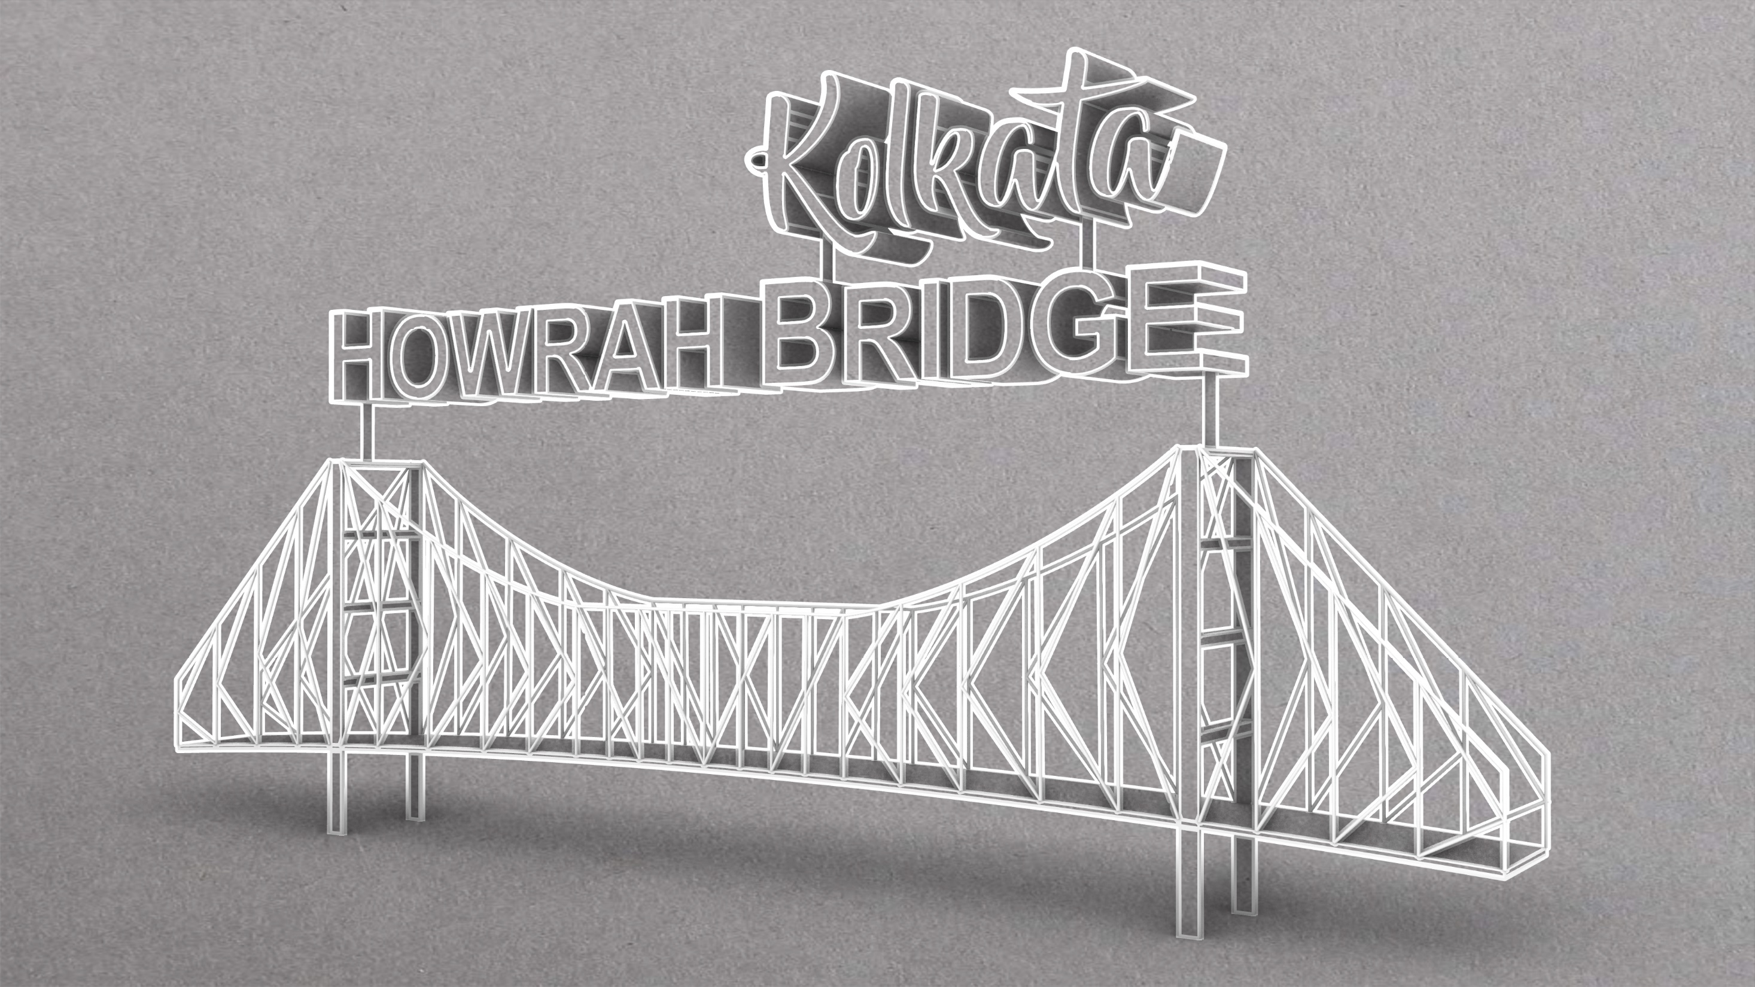

Slide 15
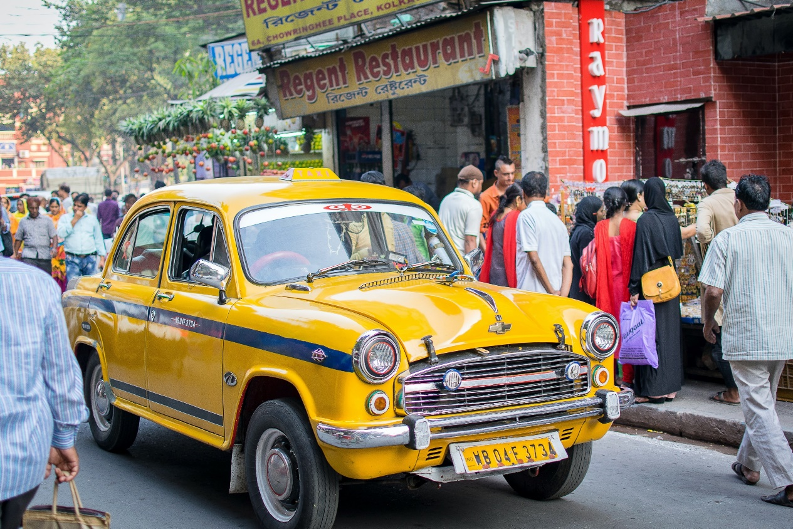
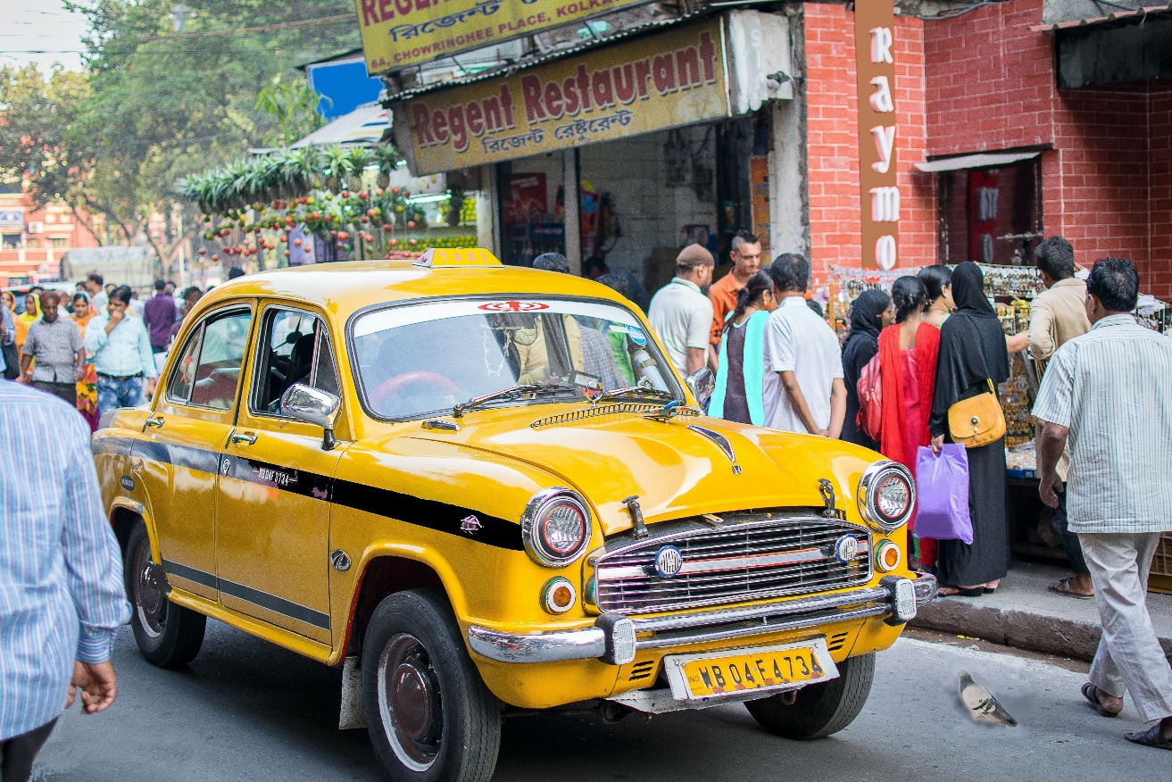
Spot The Difference
Photo by Vishal Bhutani on Unsplash
Find the 10 differences in these Kolkata street scenes

Slide 16











Photo by Vishal Bhutani on Unsplash

Slide 17
Congratulations!
CLICK ON THE GLOBE ICON TO CONTINUE

Slide 18


Slide 19





Unscramble These Countries
Nadaca
Nice Lad
Bar Liz
Dukedom Tining
Hanga
Lin Fand
Gp Yet
Ian Id
Inmate Trunks
Enemy

Slide 20
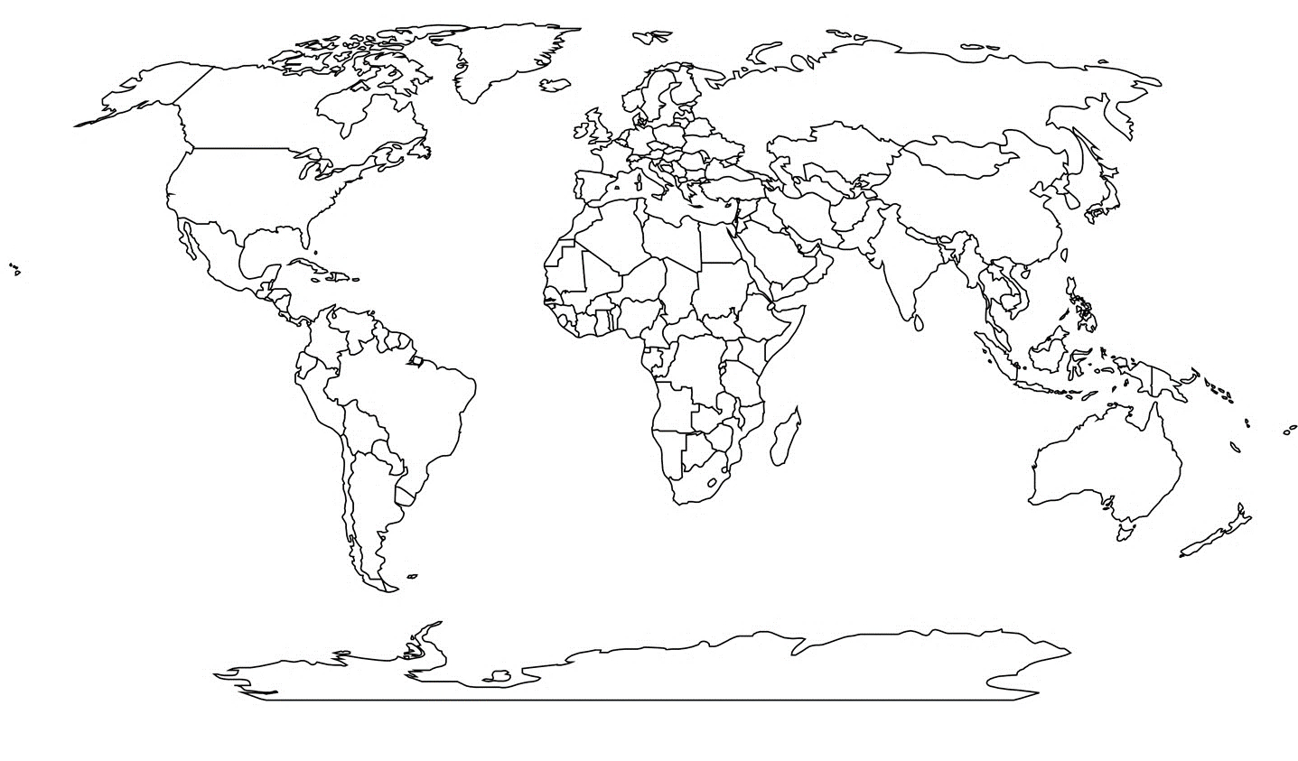
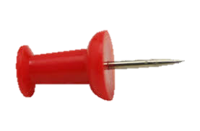
Nadaca
Nice Lad
Bar Liz
Lin Fand
Gp Yet
Ian Id
Find the Code
Inmate Trunks
Enemy
Dukedom Tining
Hanga

Slide 21




Slide 22
Congratulations!
CLICK ON THE GLOBE ICON TO CONTINUE

Slide 23
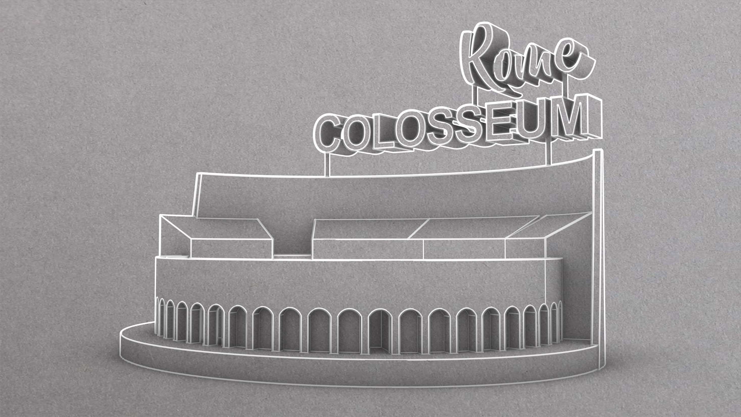

Slide 24
`
Find The Trapdoor
There were 36 trapdoors in the Colosseum that were used for special effects. One of these 36 trapdoors contains the next piece of useful information, but first you need to work out which trapdoor it is using the clues provided. Don’t get eaten by the lions in the underground passageways…
1 | 2 | 3 | 4 | 5 | 6
7 | 8 | 9 | 10 | 11 | 12
13 | 14 | 15 | 16 | 17 | 18
19 | 20 | 21 | 22 | 23 | 24
25 | 26 | 27 | 28 | 29 | 30
31 | 32 | 33 | 34 | 35 | 36

Slide 25
Congratulations!
CLICK ON THE GLOBE ICON TO CONTINUE

Slide 26


Slide 27
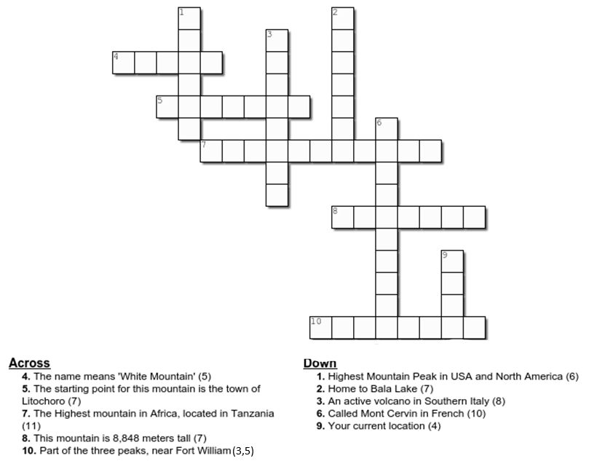
Mountain Crossword
Fill in the mountain crossword to solve the puzzle

Slide 28
Congratulations!
CLICK ON THE GLOBE ICON TO CONTINUE

Slide 29


Slide 30
Part 1 – Fill in the Blanks
The statue of liberty holds a _ _ _ _ _ above her head and a _ _ _ _ _ _ in her other hand.
Her crown has _ _ _ _ _ spikes and she wears a loose _ _ _ _ .
The five coloured letters will make an anagram of a word. This word is your code to the next part of the Statue of Liberty Challenge.

Slide 31
Part 1 – Fill in the Blanks
The statue of liberty holds a t o r c h above her head and a t a b l e t in her other hand.
Her crown has s e v e n spikes and she wears a loose r o b e .
THAER
Unscramble this to move on!

Slide 32
PART 2 – WHAT IS THE CODE?
Well Done.
For the next part of this escape room, you will need to find a ten-digit code.
The pictures on the next page are DVDs or books without their titles. By naming the title of each, you should be able to work out the 10-digit code to complete the Statue of Liberty Challenge.
There are clues for each, so you can ask for a clue at any point. Good Luck!

Slide 33

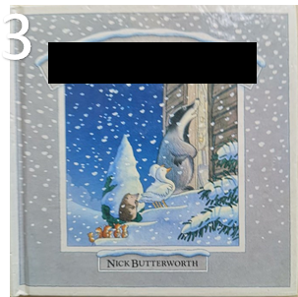
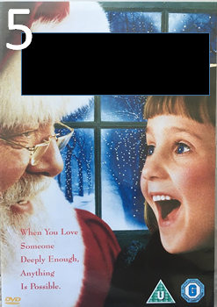

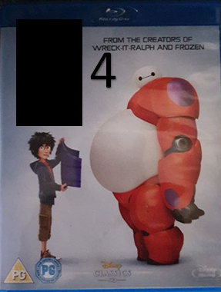


1
3
5
4
6

Slide 34
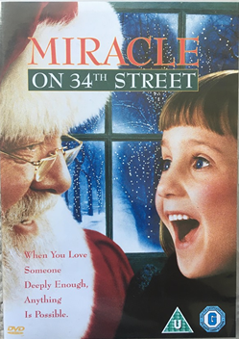
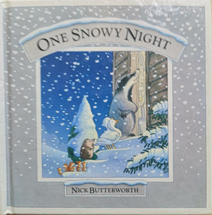
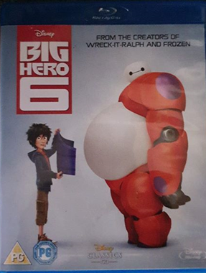
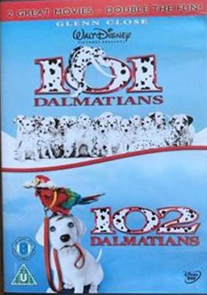
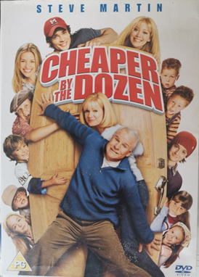
1
5
3
5
4
2
4
6

Slide 35
What is the code?
2121634101
1 7 6 2 1 5 5 0

Slide 36
Congratulations!
CLICK ON THE GLOBE ICON TO CONTINUE

Slide 37
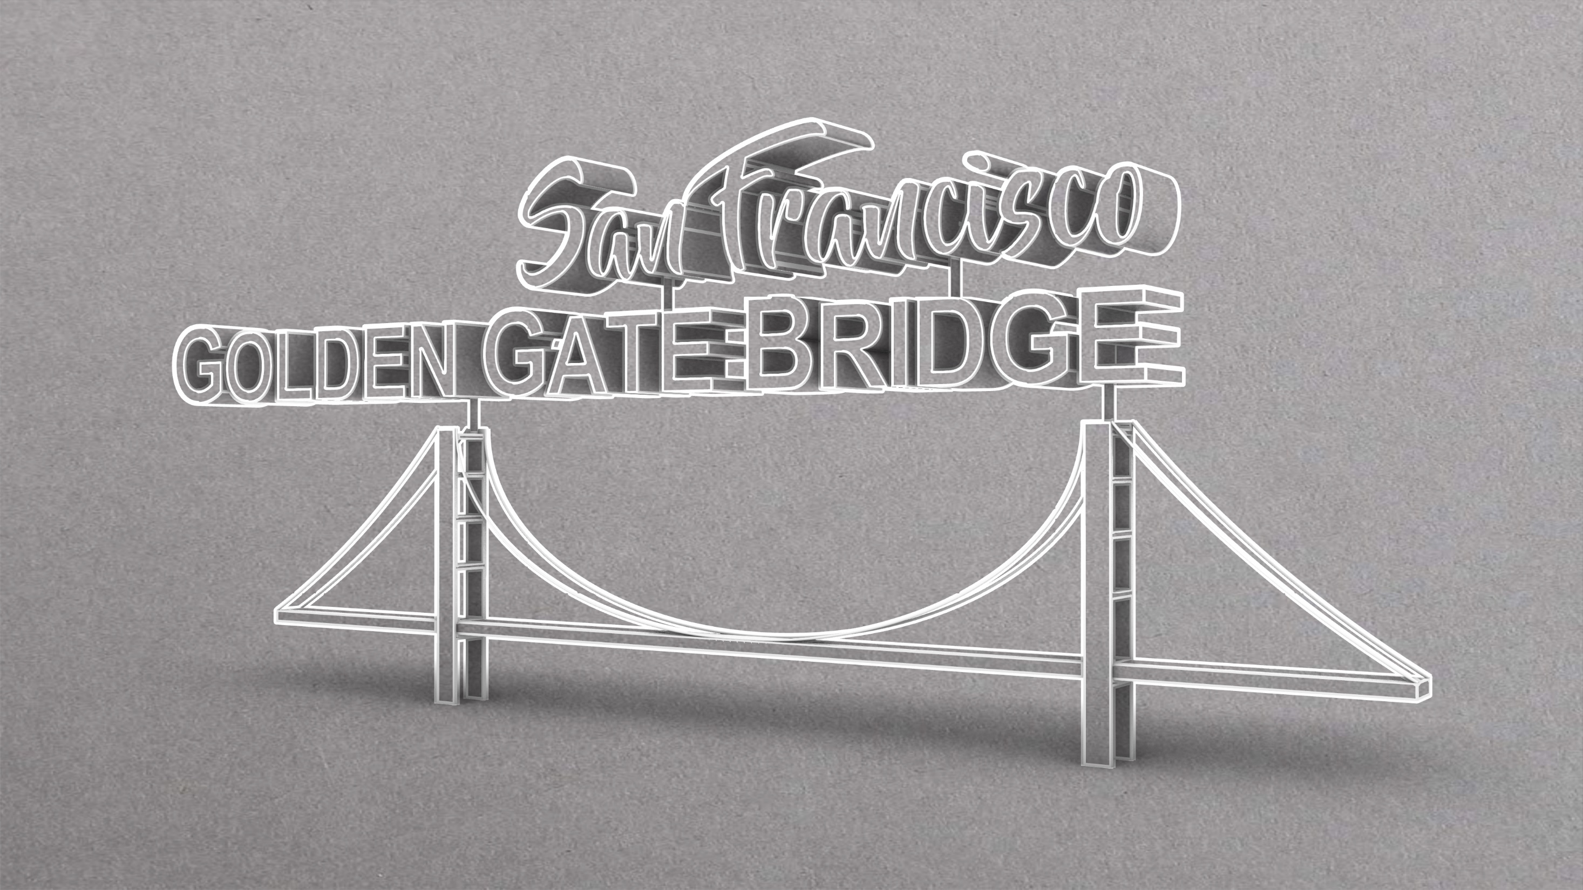

Slide 38
What Colour …?
I’ll ask you a question.
You have to each find an object the SAME colour as the answer.
You can only move on as soon as every team member has something of that colour.
Some answers might be more than one colour –
you’ll have to get more than one object!!!

Slide 39
What colour is…?
The Golden Gate Bridge?

Slide 40
What colour is…?
Beyoncé's daughter’s name?

Slide 41
What colour is…?
The SUBWAY logo?

Slide 42
What colour are…?
The ‘safe’ flags you can swim between on the beach?

Slide 43
What colour is…?
The front door of 10 Downing Street?

Slide 44
What colour are…?
The Olympic Rings?

Slide 45
Congratulations!
CLICK ON THE GLOBE ICON TO CONTINUE

Slide 46

You made it round the world!
WHAT TIME DID YOU GET?
HEAD BACK TO THE MAIN ROOM

Slide 47
Find more
free
Escape Rooms
at www.churchyouthministry.com
Designs by Jonah Ling Created by Louise Grainger, Michael Weatherall, Dave Thornton, Eleanor Bristowe and Hannah Elphick

