Slide 1
Welcome!
Created by Tim Robbins, Dave Thornton, Hannah Elphick and
A Little Elf
Design by Jack Percey

Slide 2
Here’s what you need to know
There are ten puzzles to solve before you can escape.
You can solve them in any order.
Each puzzle links from one of the Christmas presents on the next slide.
There are hints available for each puzzle, but they will cost you time penalties.
The fastest team wins. Happy solving.

Slide 3
Click on one of the top ten bags to solve a puzzle
LOVE
HOME
CHILDREN
JOY
SIMPLICITY
WONDER
PEACE
MIRACLE
IMMANUEL
GIFTS
Image by Monika Grafik from Pixabay
FINISHED

Slide 4
For God so loved the world, he sent his one and only Son. (NIV)
The Christmas story features some well-known characters. Can you identify six of them in these anagrams?
LOVE
Army
J’s Hope
Jay B. Buses
E, me, she, winter
Ken E. Piner
Earl Bigglean

Slide 5
Click on an anagram for a hint
Army
J’s Hope
Jay B. Buses
E, me, she, winter
Ken E. Piner
Earl Bigglean
Married to 2, visited by angel
Married to 1, carpenter
Probably the smallest character in the story
Sometimes called kings, they deliver gifts to Jesus. How many?
Any room?
Sent by God to deliver an important message

Slide 6
The solution:
Army MARY
J’s Hope JOSEPH
Jay B. Buses BABY JESUS
E, me, she, winter THREE WISE MEN
Ken E. Piner INNKEEPER
Earl Bigglean ANGEL GABRIEL

Slide 7
The Word became flesh and made his dwelling among us.
After the Christmas celebrations
All the decorations need to be put away.
Can you work out how to put these baubles back in their home?
HOME

Slide 8
Place the 12 baubles into the boxes so that there are no more than three baubles in each row horizontally, vertically and diagonally.
Image by Monika Grafik from Pixabay

Slide 9
Place the 12 baubles into the boxes so that there are no more than three baubles in each row horizontally, vertically and diagonally.
This is what you need on the diagonals. Don’t put baubles in the yellow boxes.

Slide 10
The solution:
Here are the 12 baubles placed in the boxes so that there are no more than three baubles in each row horizontally, vertically and diagonally.
This is one solution. There are more e.g. mirror image of this solution and rotations.

Slide 11
Christmas crackers! Children (and many adults!) love silly jokes, and there are none sillier than those in Christmas crackers. Can you work out the answers to these Christmas cracker jokes?
While they were there, the time came for the baby to be born, and she gave birth to her firstborn, a son.
CHILDREN

Slide 12
What do elves learn at school? 20 8 5 5 12 6 - 1 2 5 20
What kind of photos do elves take? 5 12 6 9 5 19
What do snowmen eat for breakfast? 6 18 15 19 20 9 5 19
What do you call a reindeer
with bad manners? 18 21 4 5 - 15 12 16 8
5. What do you call Father Christmas
when he doesn’t move? 19 1 14 20 1 16 1 21 19 5
6. What does Father Christmas
use to solve puzzles? 19 1 14 20 1 3 12 21 5 19

Slide 13
Key:
1 | 2 | 3 | 4 | 5 | 6 | 7 | 8 | 9 | 10 | 11 | 12 | 13 | 14 | 15 | 16 | 17 | 18 | 19 | 20 | 21 | 22 | 23 | 24 | 25 | 26
A | B | C | D | E | F | G | H | I | J | K | L | M | N | O | P | Q | R | S | T | U | V | W | X | Y | Z
What do elves learn at school? 20 8 5 5 12 6 - 1 2 5 20
What kind of photos do elves take? 5 12 6 9 5 19
What do snowmen eat for breakfast? 6 18 15 19 20 9 5 19
What do you call a reindeer
with bad manners? 18 21 4 5 - 15 12 16 8
5. What do you call Father Christmas
when he doesn’t move? 19 1 14 20 1 16 1 21 19 5
6. What does Father Christmas
use to solve puzzles? 19 1 14 20 1 3 12 21 5 19

Slide 14
The solution:
T h e E l f - a b e t
E l f I e s
F r o s t i e s
R u d e - o l p h
S a n t a P a u s e
S a n t a C l u e s
What do elves learn at school? 20 8 5 5 12 6 - 1 2 5 20
What kind of photos do elves take? 5 12 6 9 5 19
What do snowmen eat for breakfast? 6 18 15 19 20 9 5 19
What do you call a reindeer
with bad manners? 18 21 4 5 - 15 12 16 8
5. What do you call Father Christmas
when he doesn’t move? 19 1 14 20 1 16 1 21 19 5
6. What does Father Christmas 19 1 14 20 1 3 12 21 5 19
use to solve puzzles?

Slide 15
I bring you good news that will cause great joy for all the people.
Music is one way for people to express joy.
Can you work out what these Christmas songs are?
JOY

Slide 16
These are all familiar Christmas songs.
Can you work out what they all are?
1.
2.
3.
4.
5.

Slide 17
These are the answers, but in the wrong order.
1.
Jingle Bells
Away in a Manger
We Wish You a Merry Christmas
Silent Night
Once in Royal David’s City
2.
3.
4.
5.

Slide 18
The solution for 1-5 (there’s 6-10 to go)
1.
1. We Wish You a Merry Christmas
2. Once in Royal David’s City
3. Silent Night
4. Jingle Bells
5. Away in a Manger
2.
3.
4.
To next 5 songs
5.

Slide 19
These are all familiar Christmas songs.
Can you work out what they all are?
6.
7.
8.
9.
10.

Slide 20
These are the answers, but in the wrong order.
6.
7.
8.
O Come All Ye Faithful
Hark the Herald
The Holly and the Ivy
While Shepherds Watched
O Little Town of Bethlehem
9.
10.

Slide 21
The solution for 6-10
6.
7.
8.
6. Hark the Herald
7. O Come All Ye Faithful
8. O Little Town of Bethlehem
9. The Holly and the Ivy
10. While Shepherds Watched
9.
10.

Slide 22
So they hurried off and found Mary and Joseph, and the baby, who way lying in the manger.
Wood and trees are simple things.
This puzzle is about a Christmas tree.
SIMPLICITY

Slide 23
Place the numbers 1 to 9 once each into the baubles on the tree, so that the total of the red baubles is twice the total of the orange baubles.

Slide 24
Place the numbers 1 to 9 once each into the baubles on the tree, so that the total of the red baubles is twice the total of the orange baubles.
1 | 2 | 3 | 4 | 5 | 6 | 7 | 8 | 9
The numbers 1 to 9 add up to 45, so the red baubles need to add up to 30, while the orange baubles add up to 15.

Slide 25
A solution:
1
Orange: add to 15
Red: add to 30
Left is one possible solution but there are more.
4
2
3
5
6
7
8
9

Slide 26
For to us a child is born… and he will be called Wonderful Counsellor, Mighty God, Everlasting Father, Prince of Peace.
Can you work out who these people are?
They’re all from the Christmas story.
WONDER
YYY
1.
2.
3.

Slide 27
Can you work out who these people are?
YYY
Symbol for Male
1.
A spill out of a pen, perhaps
What sound does a cat make?
2.
If this ring belonged to a woman, it would be ___ ring
It’s not a staff, not a stick, begins with ‘r’
3.

Slide 28
The solution:
YYY
Three Wise Men
1.
Innkeeper
2.
King Herod
3.

Slide 29
Glory to God in the highest and on earth peace.
This is how to say Happy Christmas in some other languages.
Can you work out which languages they are?
PEACE
1. Joyeux Noël | 5. Buon Natale
2. Feliz Navidad | 6. Nadolig Llawen
3. God Jul | 7. Fröhliche Weihnachten
4. Mutlu Noeller | 8. Feliz Natal

Slide 30
This is how to say Happy Christmas in some other languages.
1. Joyeux Noël | 5. Buon Natale
2. Feliz Navidad | 6. Nadolig Llawen
3. God Jul | 7. Fröhliche Weihnachten
4. Mutlu Noeller | 8. Feliz Natal
These are the languages (BUT IN THE WRONG ORDER!).
French | German
Italian | Portuguese
Spanish | Swedish
Turkish | Welsh

Slide 31
The solution:
1. Joyeux Noël | 1. French
2. Feliz Navidad | 2. Spanish
3. God Jul | 3. Swedish
4. Mutlu Noeller | 4. Turkish
5. Buon Natale | 5. Italian
6. Nadolig Llawen | 6. Welsh
7. Fröhliche Weihnachten | 7. German
8. Feliz Natal | 8. Portuguese

Slide 32
The virgin will conceive and give birth to a son.
I hope you won’t need a miracle to solve this puzzle!
MIRACLE
Can you join the nine dots with four straight lines, without taking your pen off the page, to create a Christmassy shape?

Slide 33
Can you join the nine dots with four straight lines, without taking your pen off the page, to create a Christmassy shape?
Hint 1: the lines can continue outside the shape.

Slide 34
Can you join the nine dots with four straight lines, without taking your pen off the page, to create a Christmassy shape?
Hint 1: The lines can continue outside the shape.
Hint 2: Try starting at the bottom circle and going straight up.

Slide 35
Can you join the nine dots with four straight lines, without taking your pen off the page, to create a Christmassy shape?
Hint 1: The lines can continue outside the shape.
Hint 2: Try starting at the bottom circle and going straight up.
Hint 3: Continue to the top circle, go down and right, then turn horizontal.

Slide 36
CLICK TO REVEAL THE SOLUTION
The solution:

Slide 37
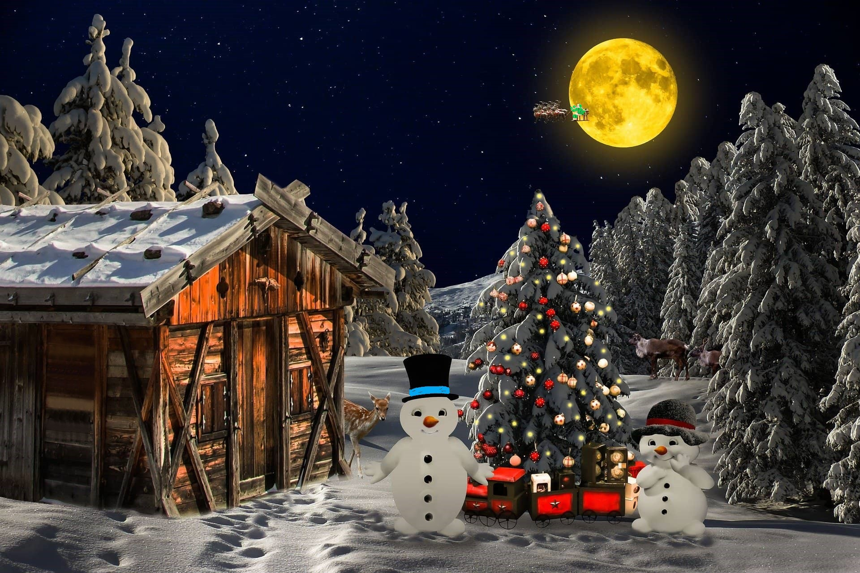
And they will call him Immanuel (which means ‘God with us’).
Spot the 10 differences
IMMANUEL

Slide 38
Congratulations!

Slide 39
Then they opened their treasures and presented him with gifts of gold, frankincense and myrrh.
I have gifts covered with 3 different wrapping papers:
GIFTS
All, but six of them, are plain.
All, but six of them, have stripes.
All, but six of them, have stars.
How many of each do I have?

Slide 40
I have gifts covered with 3 different wrapping papers:
All, but six of them, are plain.
All, but six of them, have stripes.
All, but six of them, have stars.
How many of each do I have?
Hint: There are nine presents altogether.

Slide 41
The solution:
I have three presents in each type of wrapping paper.

Slide 42
You’re free!
Amazing job! Well done!
Stop the clock!
Remember to send in your time to the website.
If you want to play some more Escape Rooms (they are really easy to run), check out:
www.churchyouthministry.com

Slide 43
Happy Christmas
Leave the Breakout Room and return to the main room when you’re ready.
www.churchyouthministry.com

