Slide 2
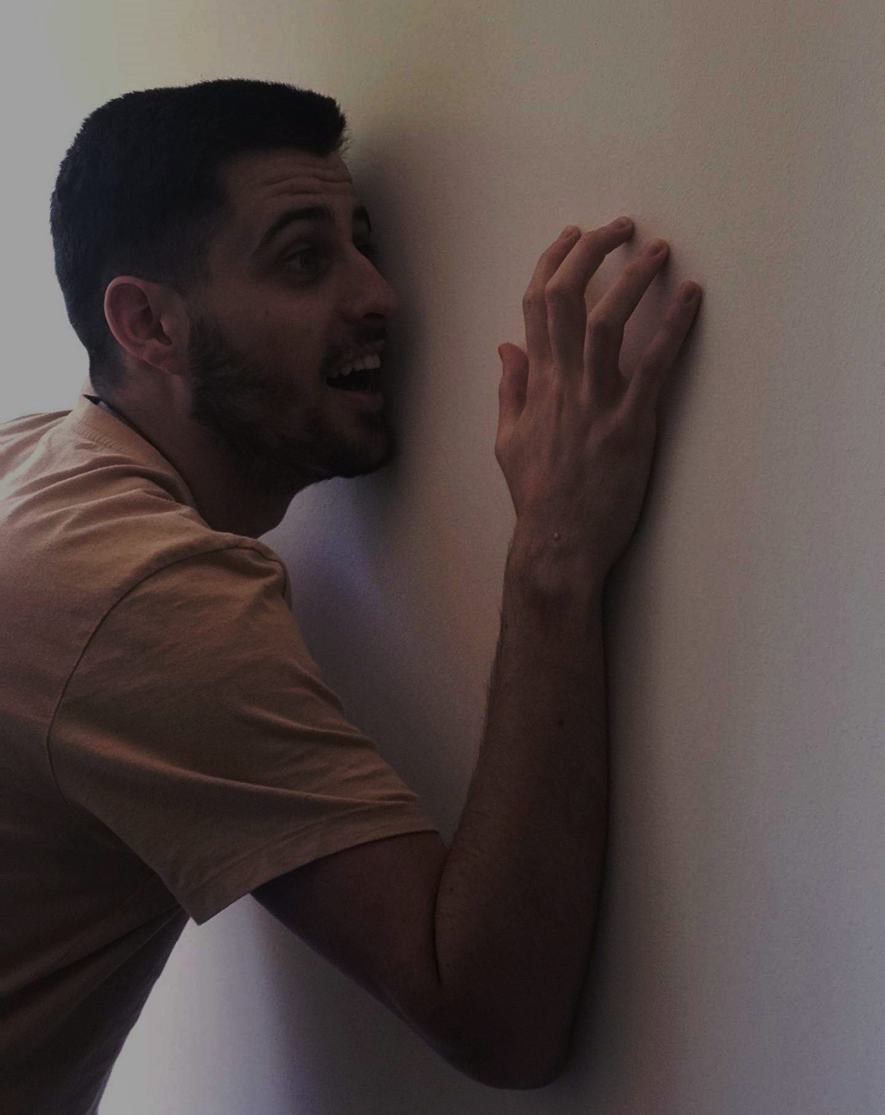
Vicar Ron Sou has been locked in the church

Slide 3
UNLOCK THE NEXT PHOTO BY DOING THE TASK
CODE 1

Slide 4
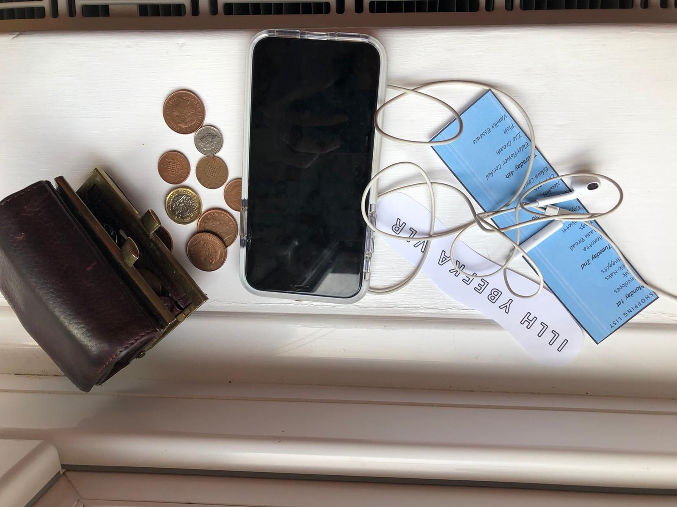
CODE 1

Slide 5
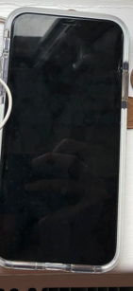
CODE 1

Slide 6
CODE 1

Slide 7
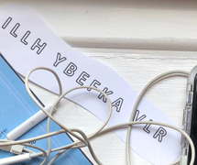
CODE 1

Slide 8
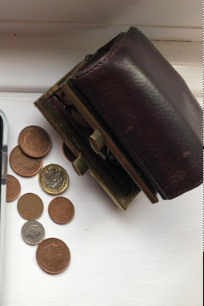
CODE 1

Slide 9
CODE 2
VRS
A REAL SHOP
VISA DEBIT
Contactless
Nuggets £2.50
Ink £5.00
Nik-Naks £1.50
Envelopes £3.23
Spaghetti £2.93
Eggs £1.32
Vienetta £1.40
Eggplant £0.80
Naan Bread £1.00
Oranges £1.50
Noodles £0.90
Edam Cheese £2.20
Fish £1.90
Ice Cream £0.90
Vanilla Essence £1.80
Elderflower Cordial £2.30
TOTAL £31.18
**********************************
POINTS EARNED: 12
TOTAL POINTS: 35
POINTS WORTH: £4.35
PLEASE KEEP FOR YOUR RECORDS.
IF YOU ARE UNSATISFIED WITH YOUR PURCHASE, PLEASE RING THE FOLLOWING NUMBER.
You’ll need a number at the bottom of this receipt then remove this box
Leader’s number here

Slide 10
CODE 3

Slide 11
CODE 3
I L L H Y B E F K A V L R

Slide 12
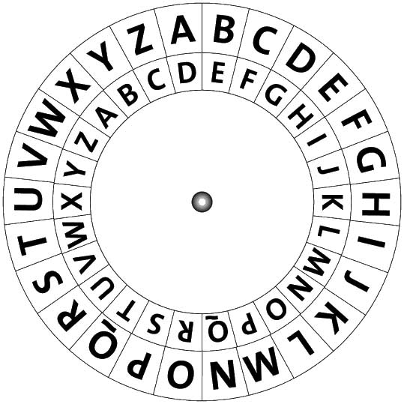
I L L H Y B E F K A V L R
CODE 3

Slide 13
CODE 4
VICAR RON SOU

Slide 14
CODE 4
CORONAVIRUS

Slide 15
CODE 4
Father Christmas is sipping from a can containing an orange-flavoured drink.

Slide 16
CODE 4
JK Rowling character is snuggling with a friendly river-dwelling animal.

Slide 17
CODE 4
British astronaut is holding a vegetable like a long onion.

Slide 18
CODE 4
X-Factor judge kicked another football player.

Slide 19
CODE 4
Paul Hollywood’s Bake-Off granny friend is eating this red fruit.

Slide 20
CODE 4
This well-known presenting duo are going on a nice long hike.

Slide 21
CODE 4
Labour leader is riding a tall and fluffy animal.

Slide 22
CODE 4
Prince William’s wife is cutting the ribbon at a church event.

Slide 23
CODE 4
English footballer is having a boogie in a storm.

Slide 24
CODE 4

Slide 25
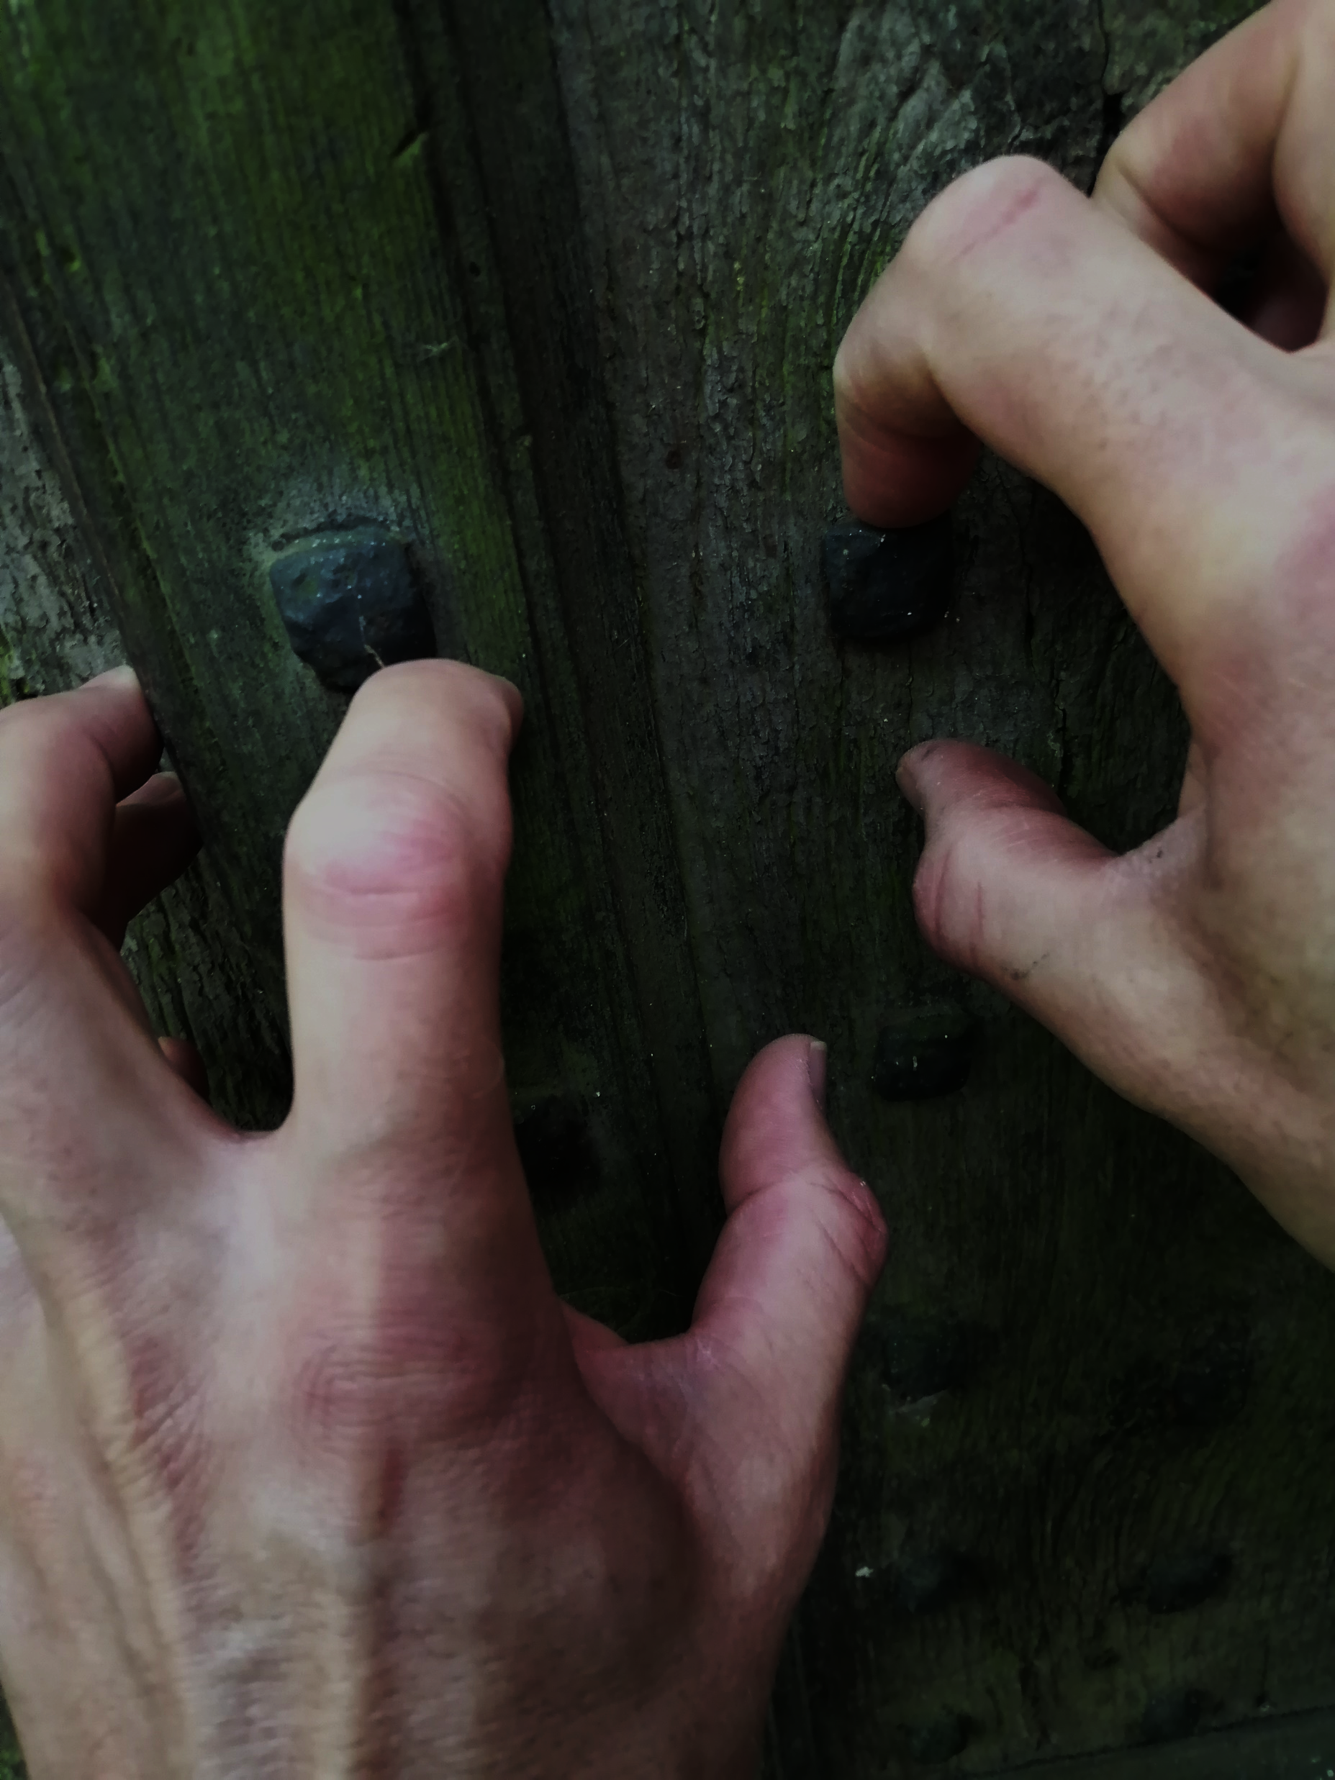
Locked in!

Slide 26
Free!
but still socially-distancing
Written by Louise Grainger 2020 Downloaded from www.churchyouthministry.com

