Slide 1

Bible books
www.churchyouthministry.com

Slide 2

1
Notes:
Numbers

Slide 3

2
Notes:
Mark

Slide 4

3
Notes:
Amos (A-moss)

Slide 5

4
Notes:
Ruth (Roof)

Slide 6
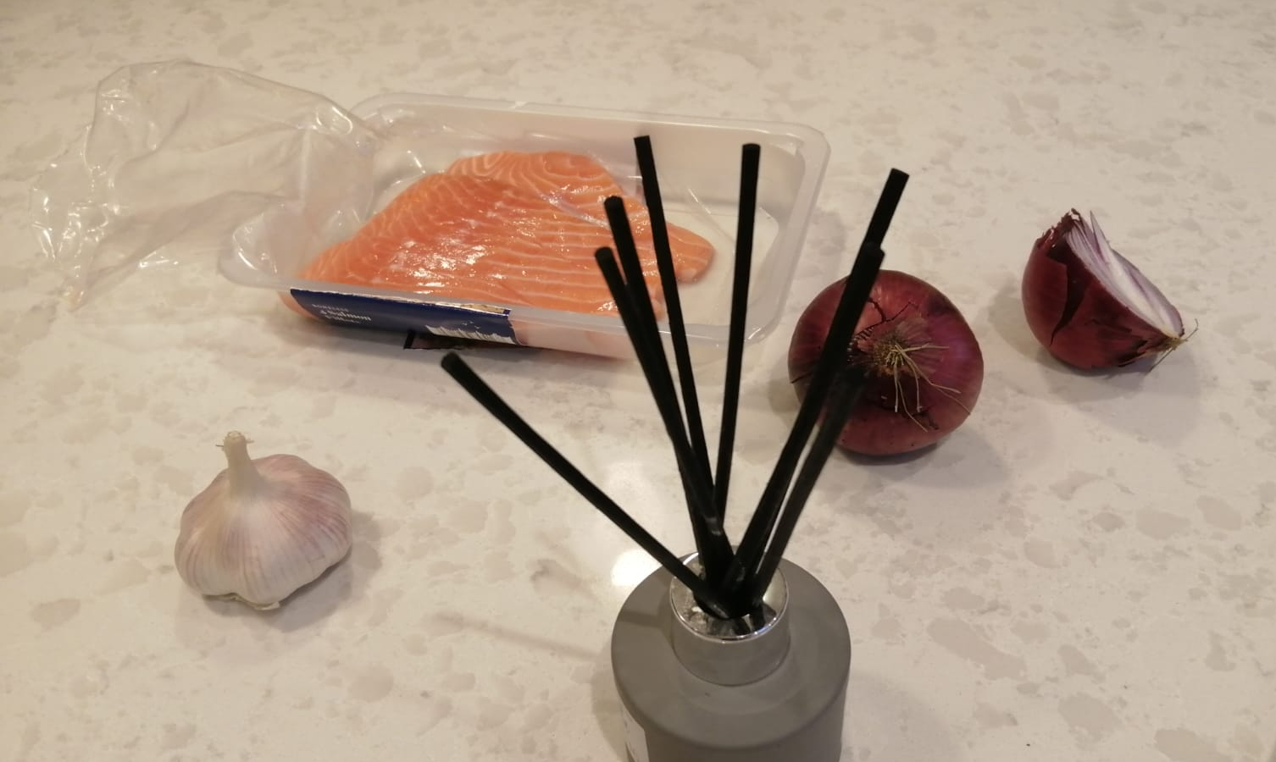
x
5
Notes:
Exodus (Ex-odours)

Slide 7

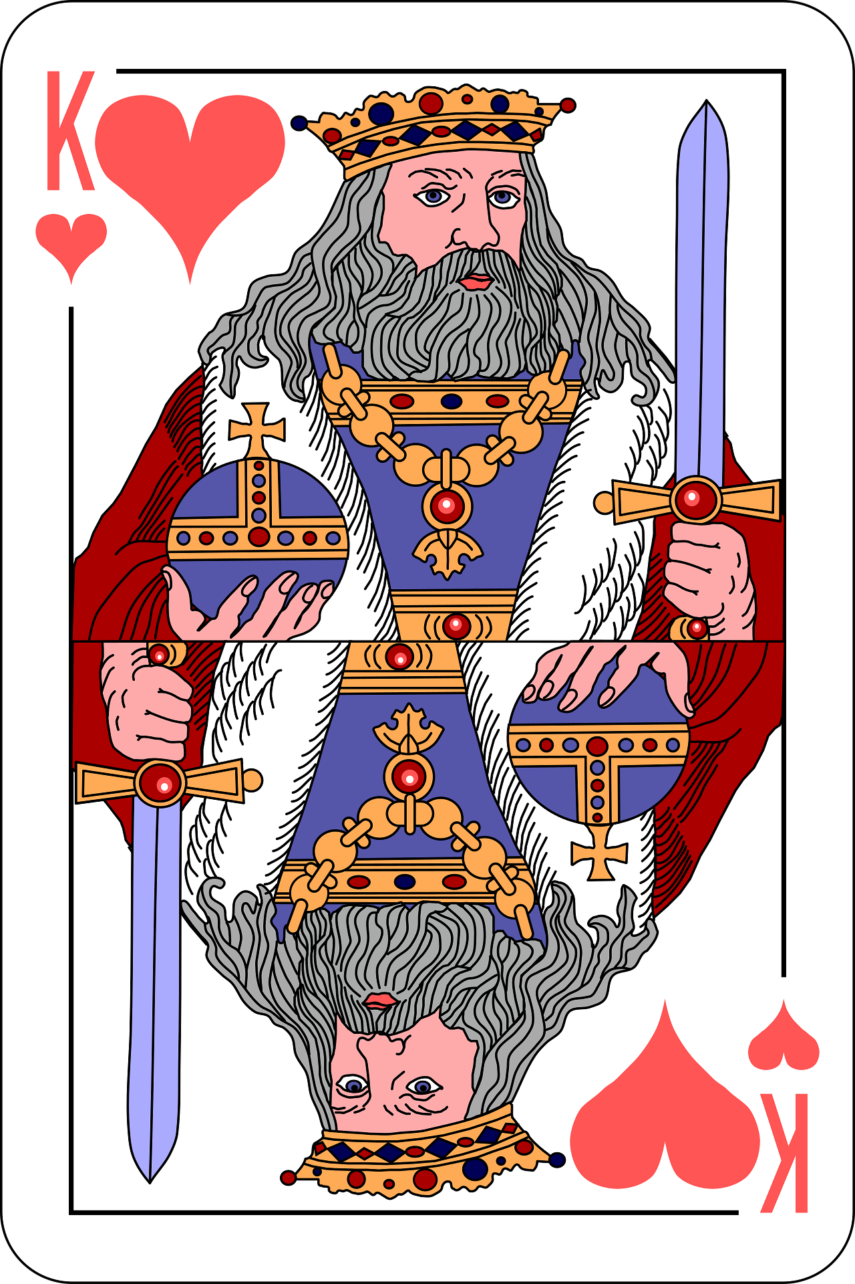
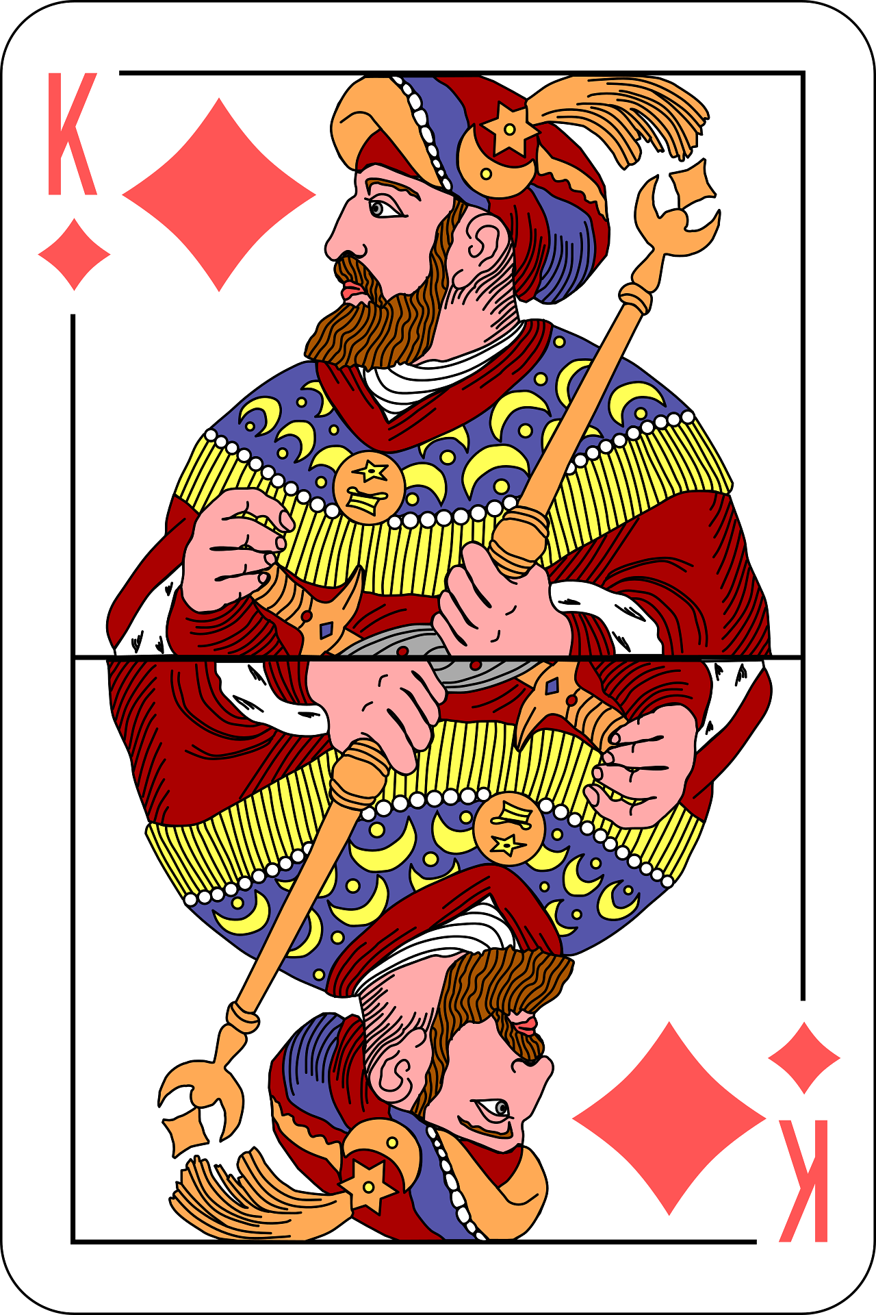
6
Notes:
2 Kings

Slide 8

7
Notes:
Luke (Look)

Slide 9
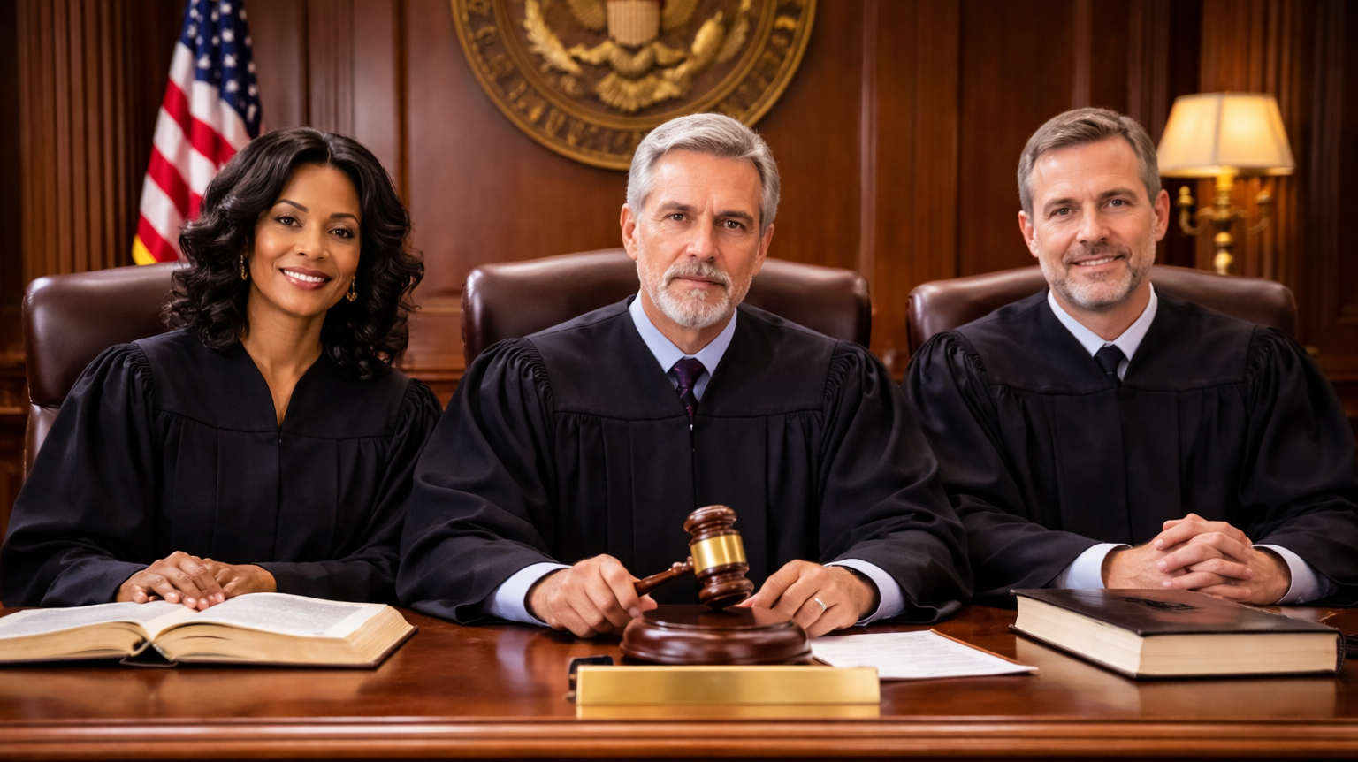
8
Notes:
Judges

Slide 10
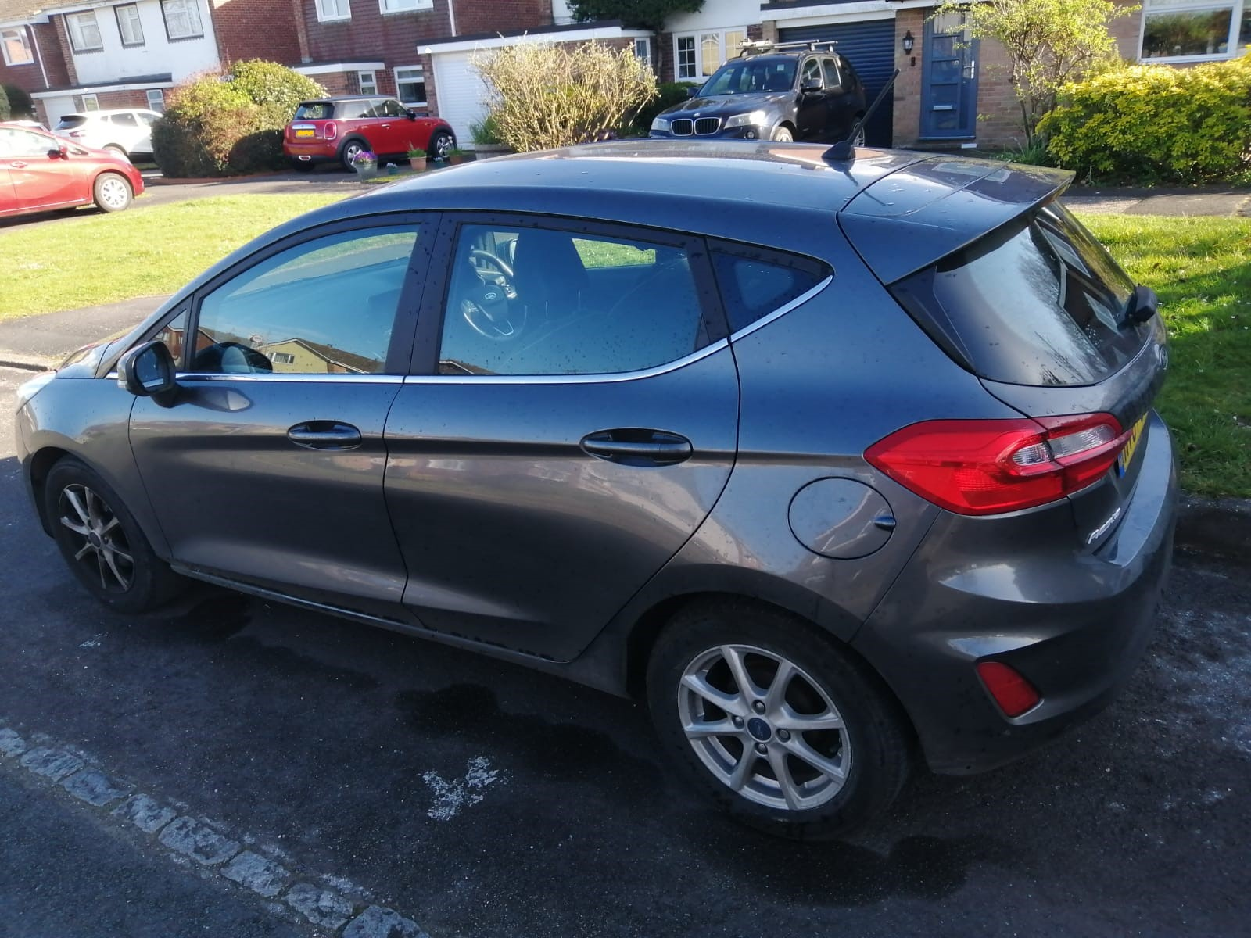
9
Notes:
Micah (My car) – I’d suggest replacing this one with a photo of your own car.

Slide 11
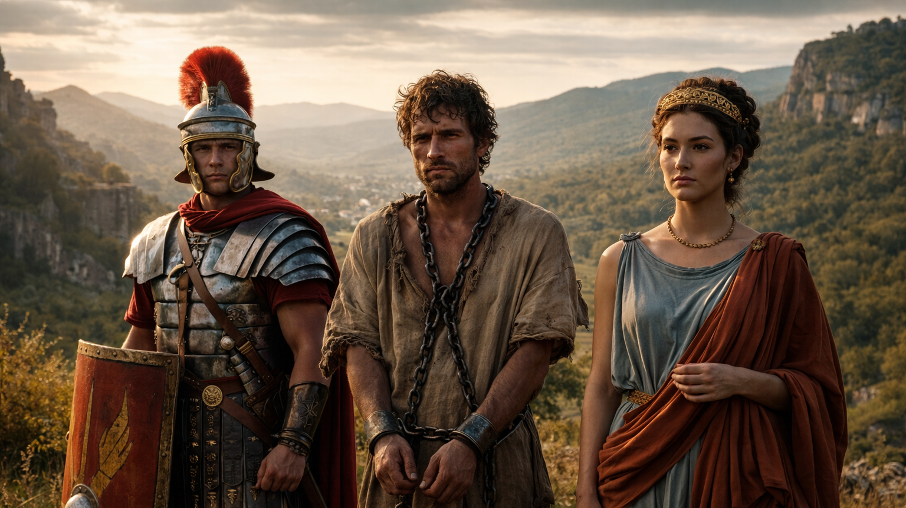
10
Notes:
Romans

Slide 12
People who live in glass houses shouldn’t throw stones.
11
The early bird catches the worm.
Beggars
can’t be
choosers.
Beauty is only skin deep.
A rolling stone gathers no moss.
Don’t judge a book by its cover.
Look before you leap.
Every cloud has a silver lining.
All that glitters is not gold.
An apple a day
keeps the doctor away.
A stitch in time saves nine.
When in Rome, do as the Romans do.
Too many cooks spoil the broth.
Notes:
Proverbs

Slide 13



12
Notes:
Job

Slide 14
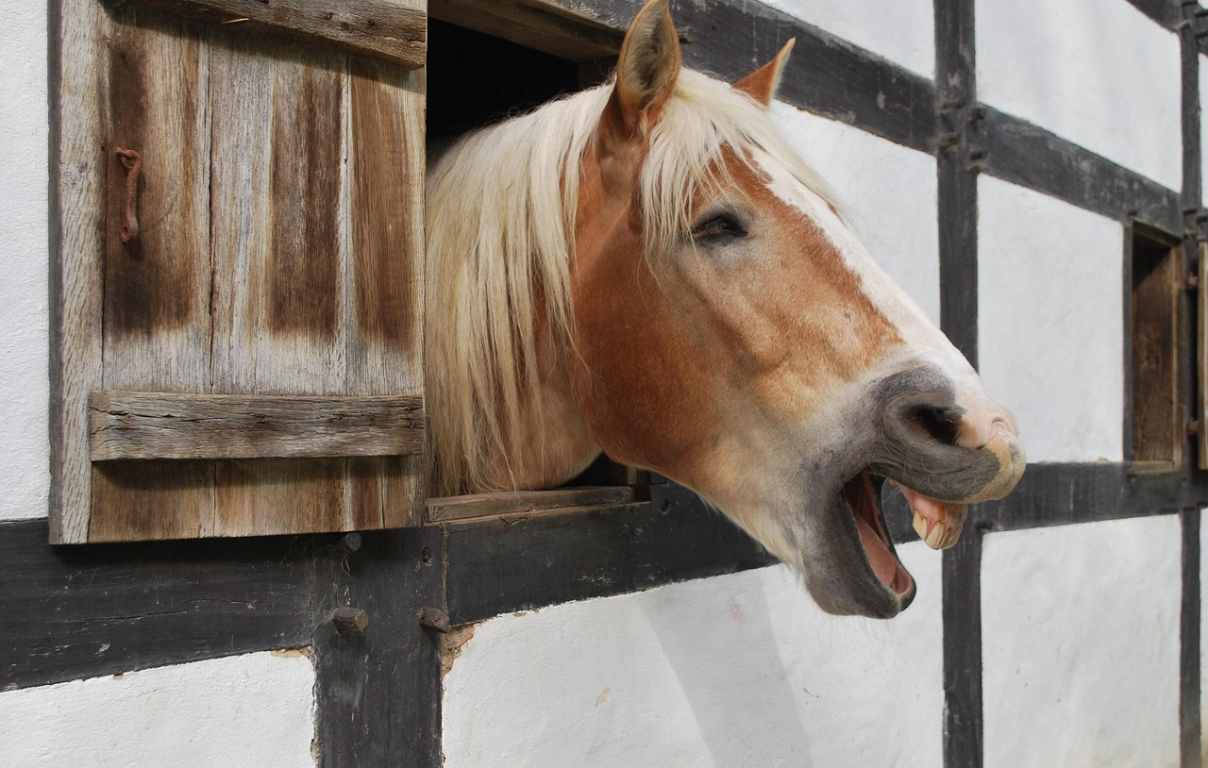

13
?
?
Notes:
Nahum (Neigh-Hum)

Slide 15
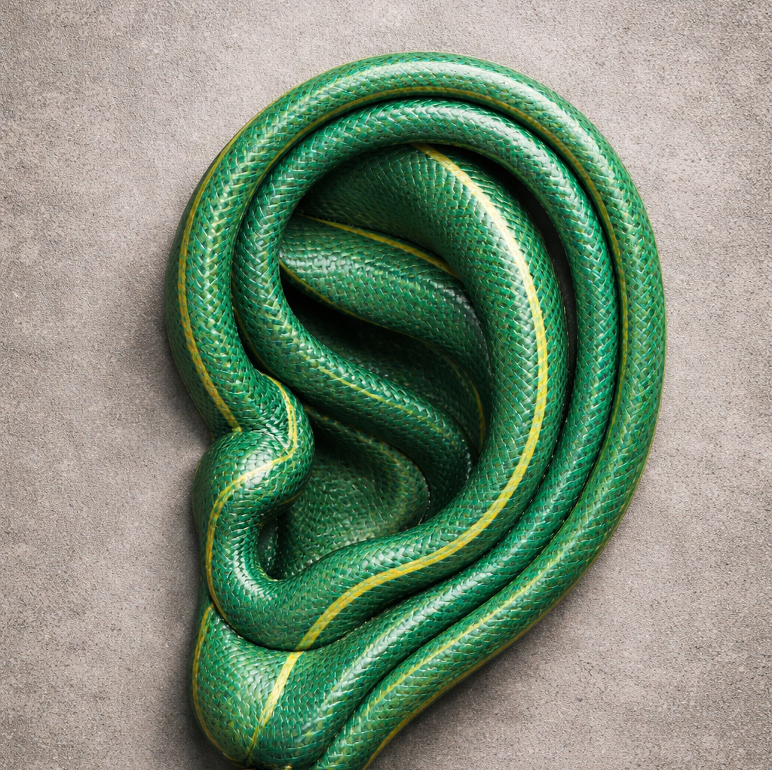
14
Notes:
Hosea (Hose Ear)

Slide 16

15
Notes:
Titus (Tight-Us)

Slide 17
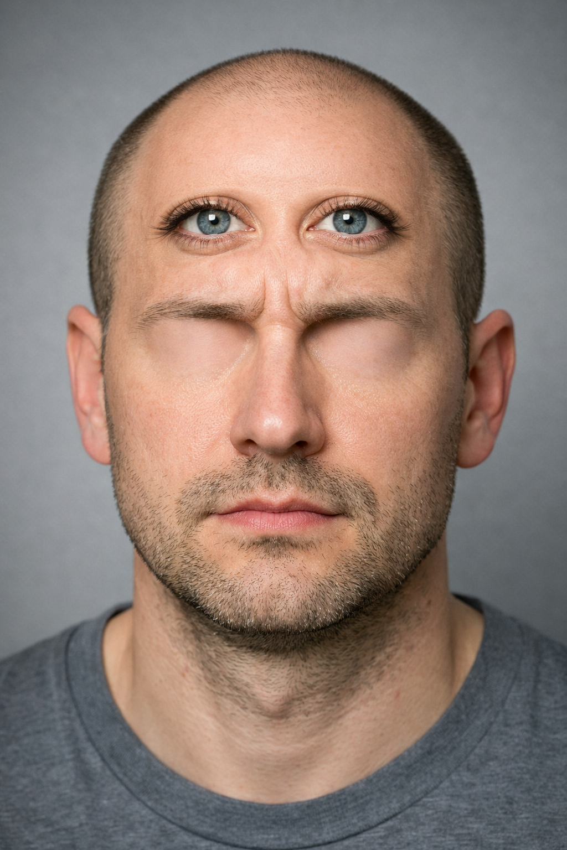
16
Notes:
Isaiah (Eyes-Higher)

Slide 18

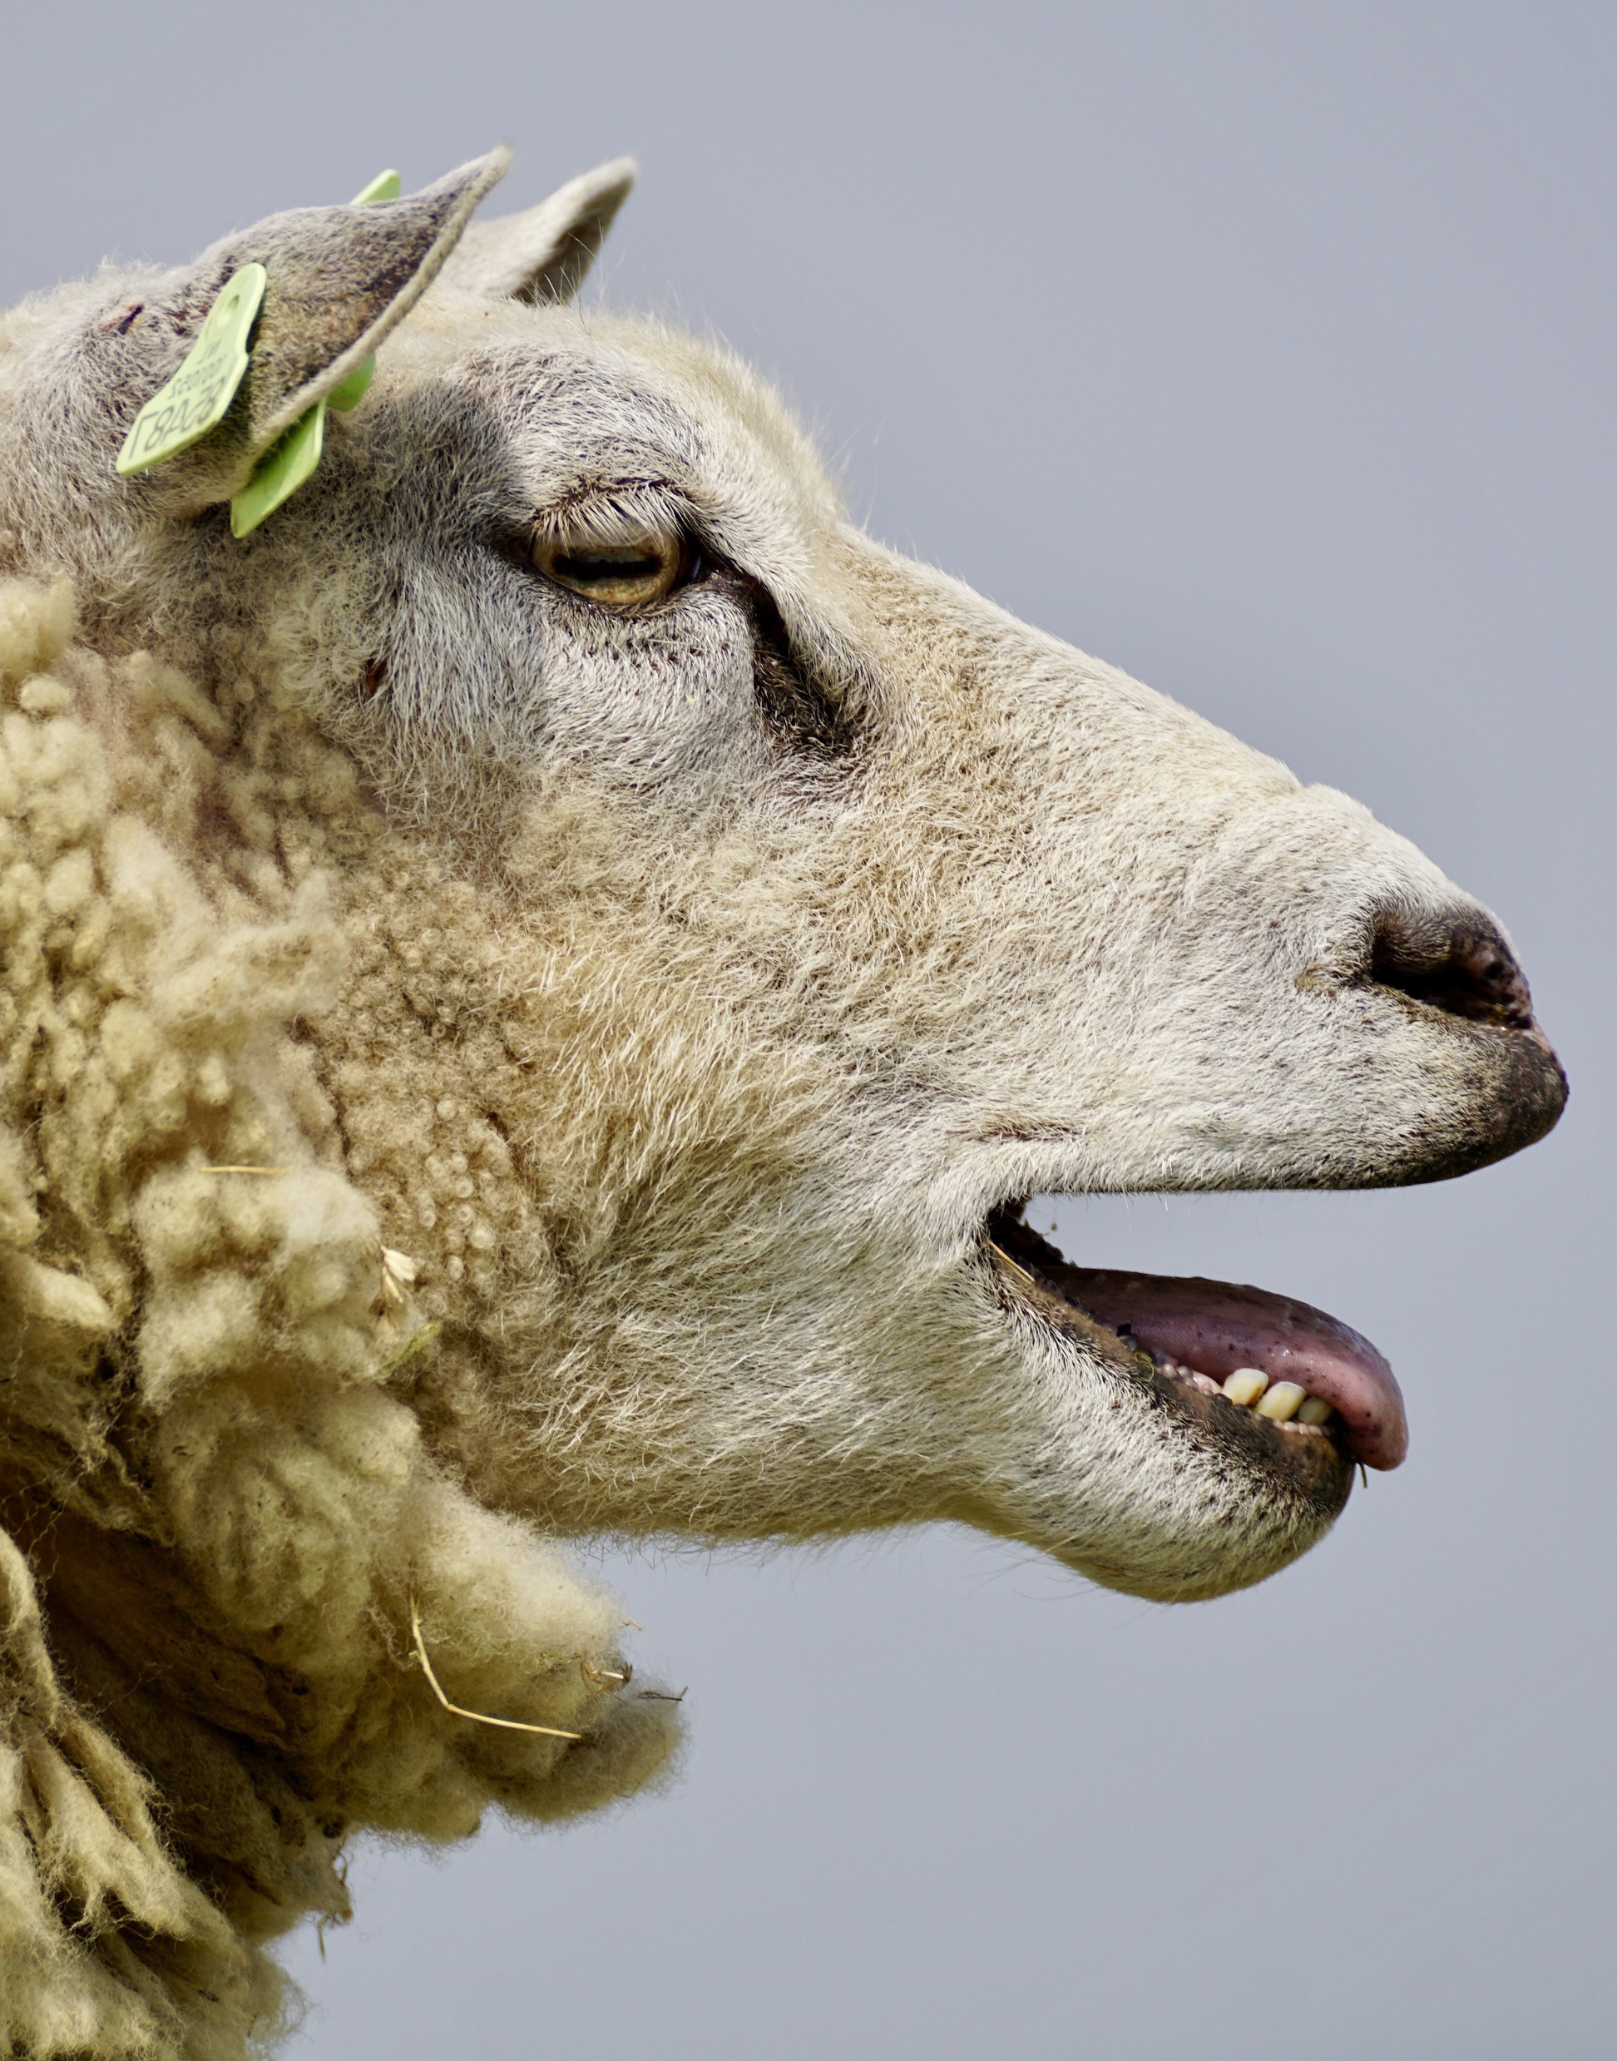
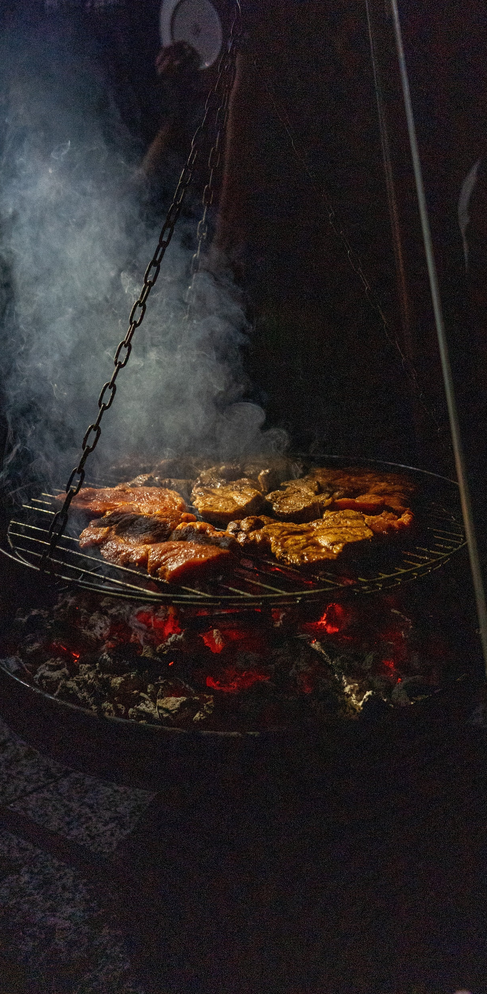
17
Notes:
Habakkuk (Ha-Baa-Cook)

Slide 19

18
Notes:
Revelation (Rev(erend)-Elation)

Slide 20

19
Notes:
Philemon (Fill-Lemon)

Slide 21

20
Notes:
Hebrews (He-Brews)

Slide 22
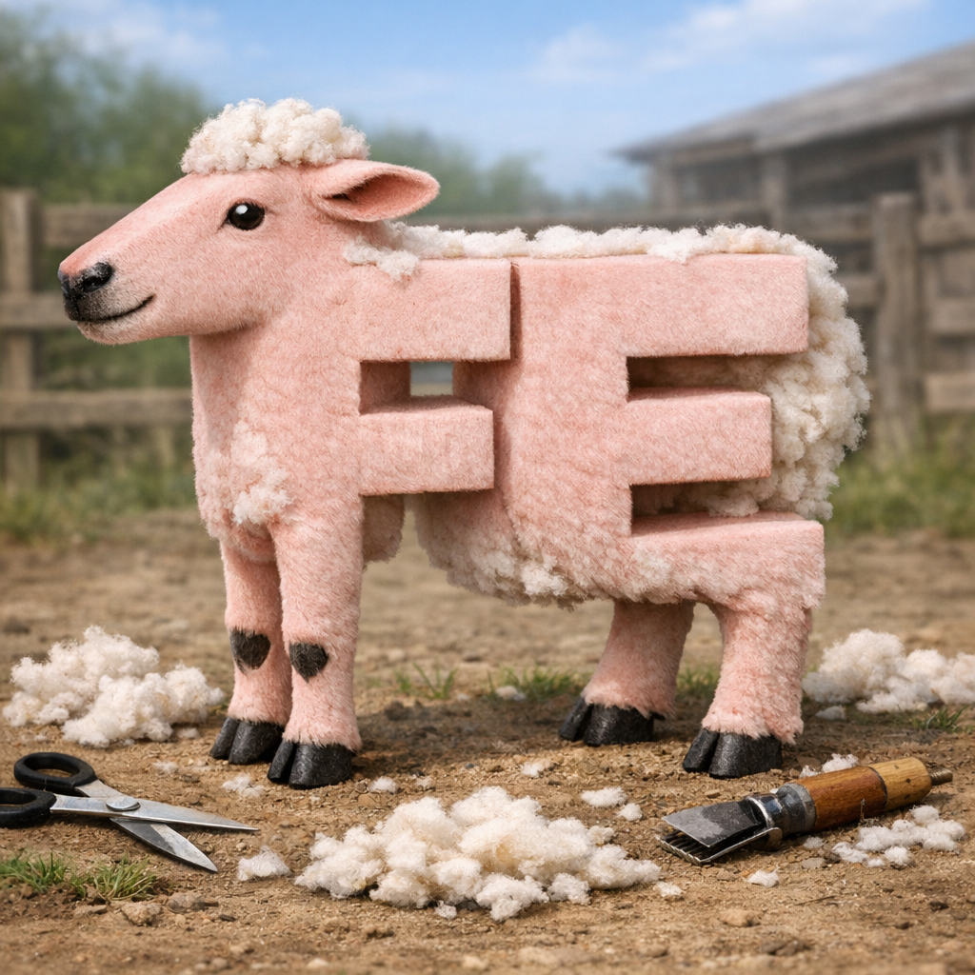
21
Notes:
Ephesians (Fe – Shorns)

Slide 23

22
Notes:
Ezra (S-Rah!)

Slide 24

23
Notes:
Acts

Slide 25

24
Notes:
Daniel (Black belt, also called Dan, kneeling)

Slide 26
Bible books
Find more ideas at www.churchyouthministry.com

