Slide 1
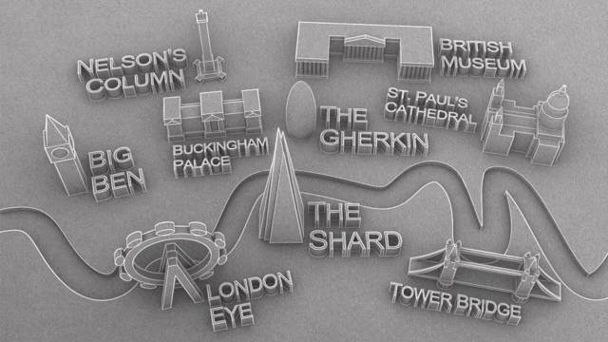
Pictures kindly drawn by Jonah Ling
Escape room created by Louise Grainger & dave Thornton 2020

Slide 2
Vicar Ron Sou is imprisoned, somewhere in London. Can you solve the puzzles to release him?

Slide 3
Click on a landmark on the next page to do a challenge
None of the places mentioned are connected with this Escape Room in any way, nor have they given permission for their names to be used.

Slide 4
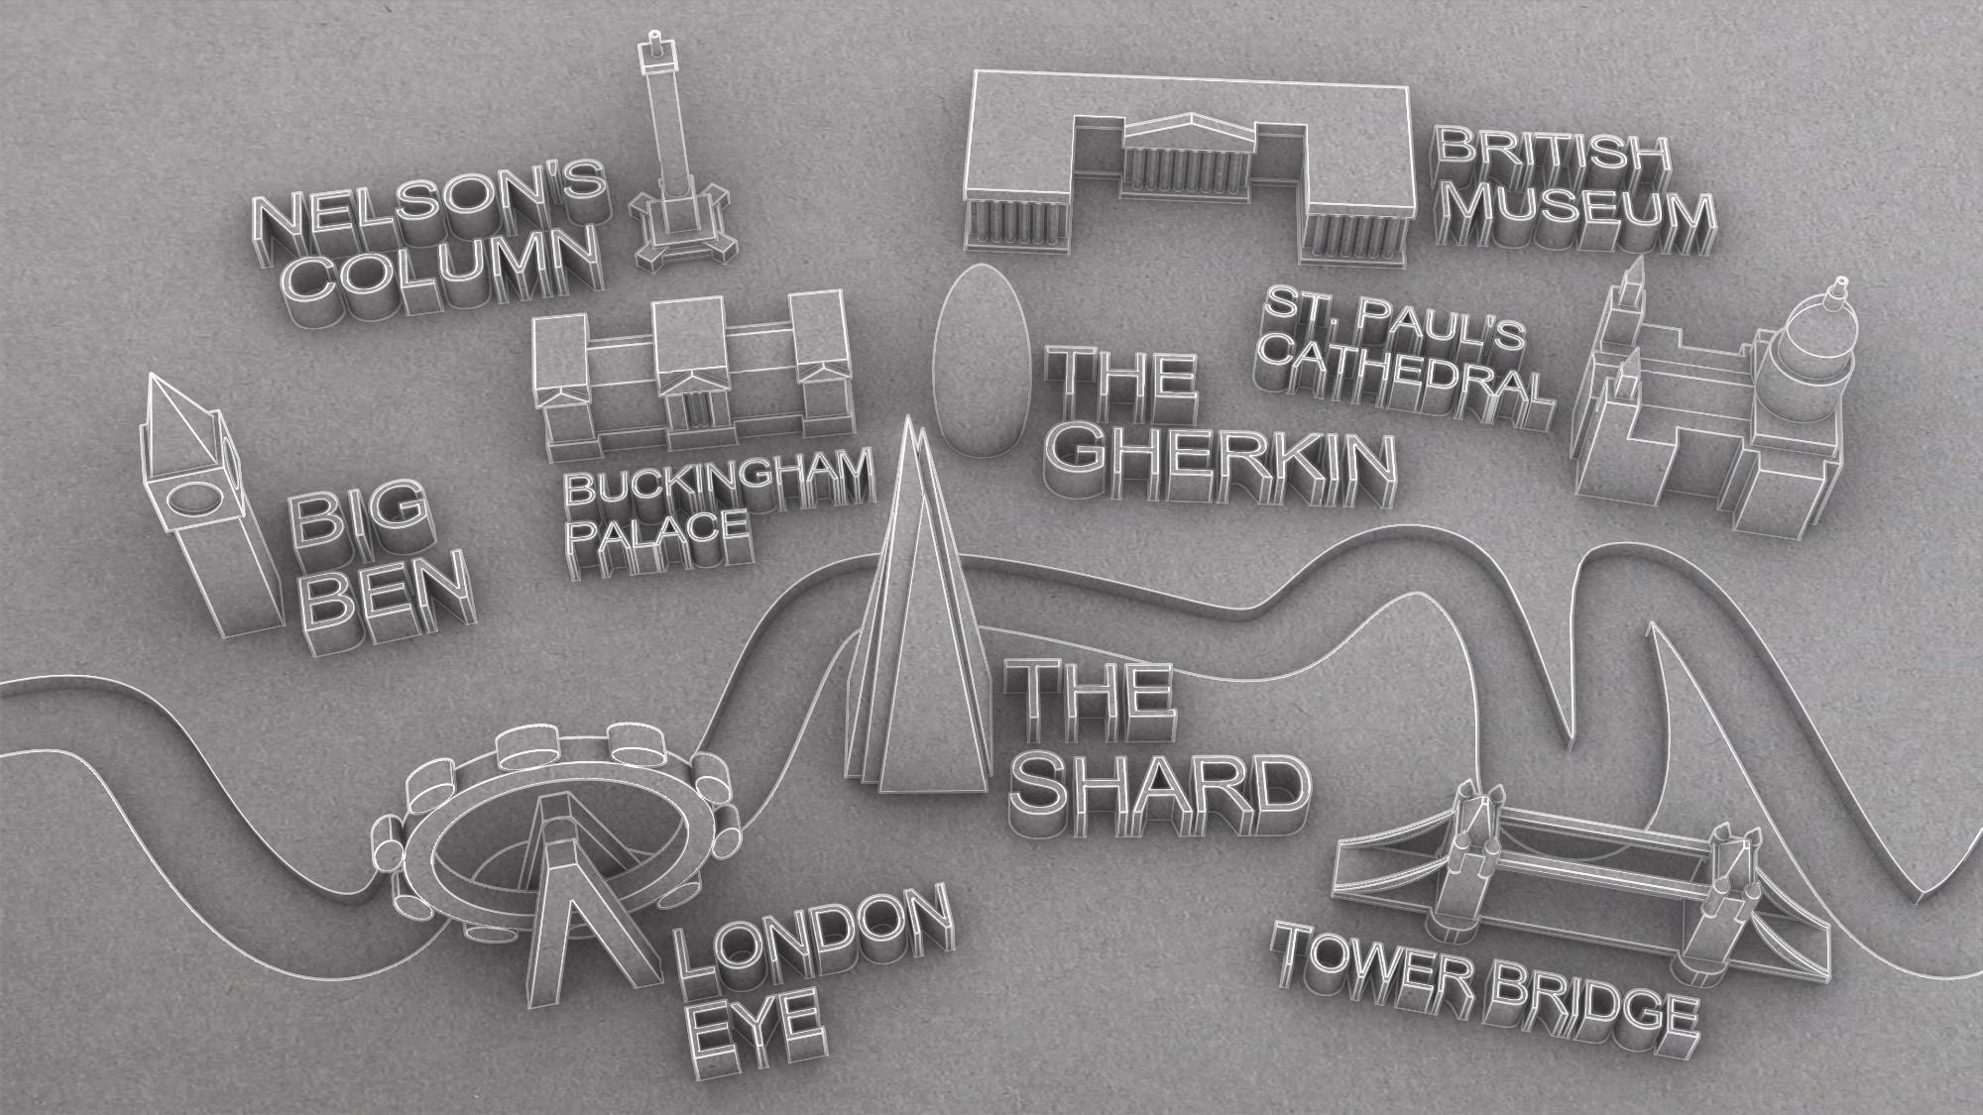

Slide 5
FILL IN THE BLANKS

Slide 6
The Duchess of Cambridge wears ______’s ________ ring.
Katniss Everdeen wears her outfit from ___________________.
Usain Bolt is doing his trademark______________.

Slide 7
The Duchess of Cambridge wears ______’s ________ ring.
Katniss Everdeen wears her outfit from ___________________.
Usain Bolt is doing his trademark______________.

Slide 8
COMPLETED BIG BEN?
RECEIVE YOUR CLUE AND click escape room logo TO RETURN TO MAP.

Slide 9
Find me...

Slide 10
Find me an object connected with LONDON

Slide 11
COMPLETED NELSON’S COLUMN?
RECEIVE YOUR CLUE AND click escape room logo TO RETURN TO MAP.

Slide 12
Spot the difference

Slide 13
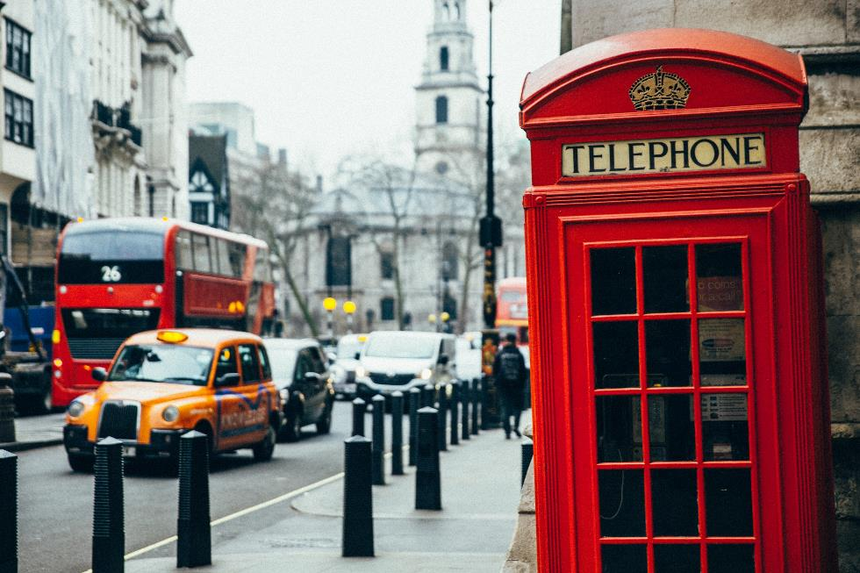
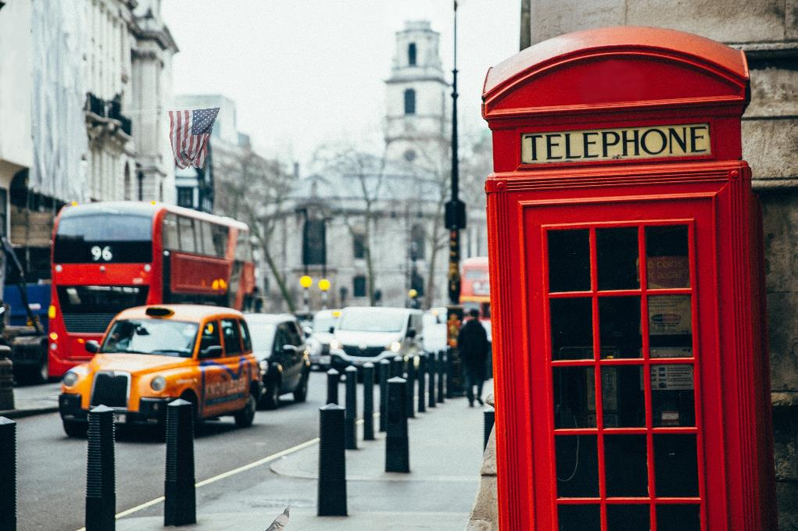

Slide 15
COMPLETED THE BRITISH MUSEUM?
RECEIVE YOUR CLUE AND click escape room logo TO RETURN TO MAP.

Slide 16
National gallery tour

Slide 17
CLICK THE PICTURE TO SEE OUR RESIDENT ART EXPERT DESCRIBING A PICTURE HE’S LOOKING AT. Listen to his description then click the national gallery virtual tour link to find it.
The National Gallery virtual tour

Slide 18
COMPLETED BUCKINGHAM PALACE?
RECEIVE YOUR CLUE AND click escape room logo to return to map.

Slide 19
Crack the code

Slide 20
CRACK THE CODE
A B C D E F G H I J K L M N O P Q R S T U V W X Y Z
ABCDEFGHIJKLMNOPQRSTUVWXYZ
What is the name of the queens last corgi?

Slide 21
COMPLETED THE GHERKIN?
RECEIVE YOUR CLUE AND click escape room logo to return to map.

Slide 22
wordsearch

Slide 23
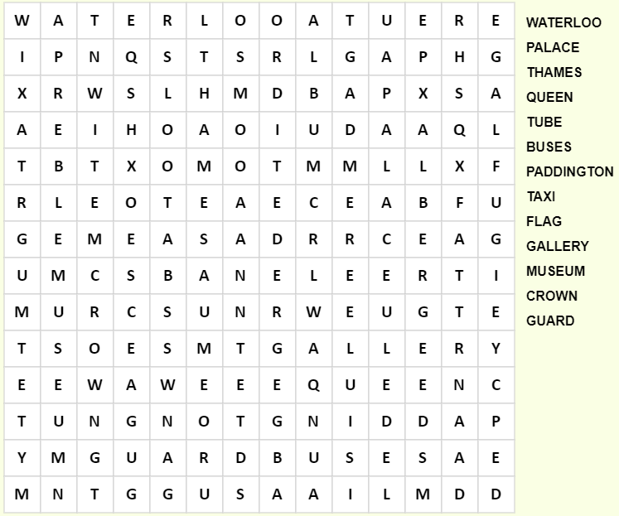
14
13
12
11
10
9
Word Search…
8
7
6
5
4
3
2
1
b
c
d
e
f
g
h
i
j
k
l
m
a
n

Slide 24
COMPLETED ST PAUL’S?
RECEIVE YOUR CLUE AND click escape room logo to return to map.

Slide 25
Solve the riddle

Slide 26
“I met an old man on London Bridge. As the sun set on the Bridge, he tipped his hat and
drew his name and cheated at the guessing game. What was the man’s name?”

Slide 27
COMPLETED THE SHARD?
RECEIVE YOUR CLUE AND click escape room logo to return to map.

Slide 28
anagrams

Slide 29
Deers Foxtrot
Acquire Treeless
Hi, the wall
Agra Fat Quarrels
Fri Maya

Slide 30
Oxford Street
Leicester Square
Whitehall
Trafalgar Square
Mayfair

Slide 31
COMPLETED THE LONDON EYE?
RECEIVE YOUR CLUE and click escape room logo to return to map.

Slide 32
colours

Slide 33
What colours are these places?
Fairlop
Stanmore
Vauxhall
Wimbledon

Slide 34
what colours are these places?
Fairlop
Stanmore
Vauxhall
Wimbledon
Fairlop
Stanmore
Vauxhall
Wimbledon

Slide 35
COMPLETED TOWER BRIDGE?
RECEIVE YOUR CLUE and click escape room logo to return to map.

Slide 36
Anything significant about the clues you’ve been given? Make sure you keep them in the same order though! What could the seven letters and numbers make?

Slide 37
SW1X 7XL
Where is this?

Slide 38
5th FLOOR
NICE SHOP DREGS
(ANAGRAM)

Slide 39
Did you find ron within the 30 minutes?
YeS
Nope

Slide 40
Vicar Ron Sou is free!!! Here he is, Safe on a boat heading down the Thames.
Escape room created by Louise Grainger & dave Thornton 2020 www.churchyouthministry.com

Slide 41
Vicar Ron Sou is trapped forever! Close, but not close enough.
Maybe next time…
Escape room created by Louise Grainger & dave Thornton 2020 www.churchyouthministry.com

Slide 43
CRACK THE CODE
A B C D E F G H I J K L M N O P Q R S T U V W X Y Z
ABCDEFGHIJKLMNOPQRSTUVWXYZ
This is surplus to requirements at the moment. If the Queen’s last corgi dies, replace Slide 20 with this one. It reads What was the name of the Queen’s last Corgi? I’m assuming she won’t replace it but check. The answer is Candy. Obviously, delete this box before you start.
What was the name of the queens last corgi?

Slide 44
CRACK THE CODE
A B C D E F G H I J K L M N O P Q R S T U V W X Y Z
ABCDEFGHIJKLMNOPQRSTUVWXYZ
This is surplus to requirements at the moment. When the Queen’s new Corgis’ names are announced, replace Slide 20 with this one. It reads What are the names of the Queen’s Corgis? The first one is Candy (unless it’s died), the other two you’ll know if they’re announced. Obviously, delete this box before you start.
What are the names of the queens corgis?

